Slide 2
Advanced Vision Technology Explained
Tim Waegeman - CTO

Slide 3
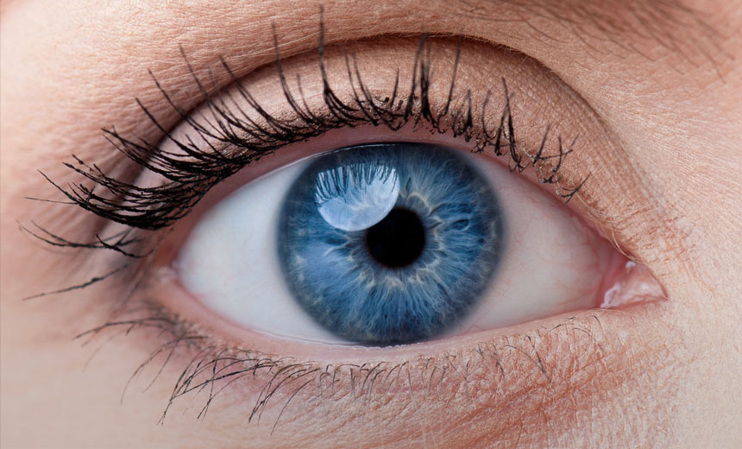
WHAT? | Vision Technology
Computer Vision (1960s)
Link with AI
Describe what you see
2D/3D
Software
Machine Vision
Interact
Real world industrial applications
Hardware
Camera
Lighting

Slide 4
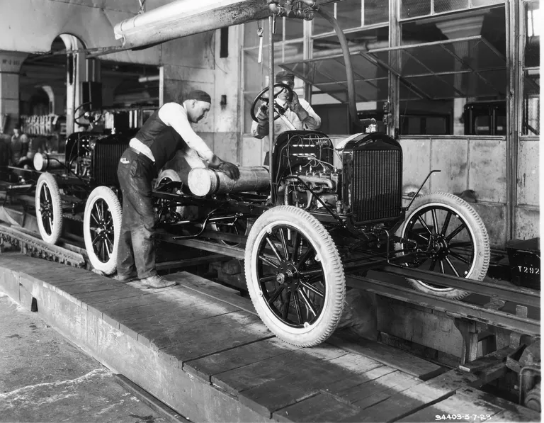
HISTORY | Manual Visual Inspections
Quality is subjective
Hard to transfer knowledge
Depends on focus
Limited throughput
Quality control limited to a fraction of production
1910

Slide 5
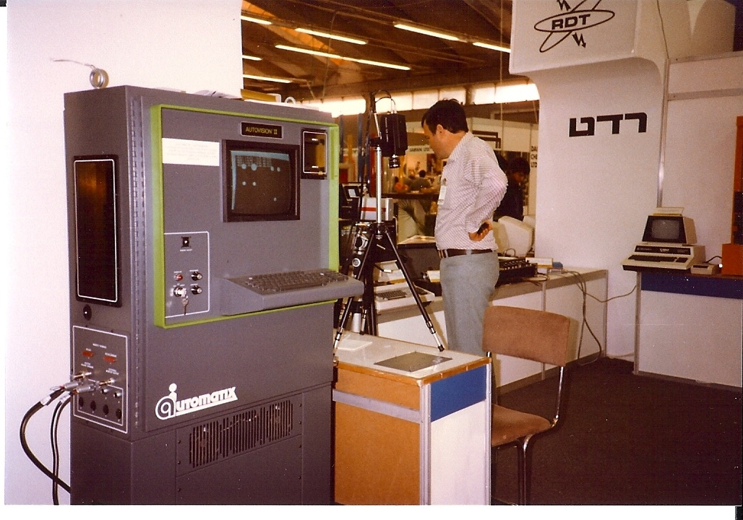
HISTORY | Early Machine Vision
Large compute unit required
Not energy efficient
Sensitive to variations
Well conditioned environment
Limited throughput
Very expensive
1983

Slide 6
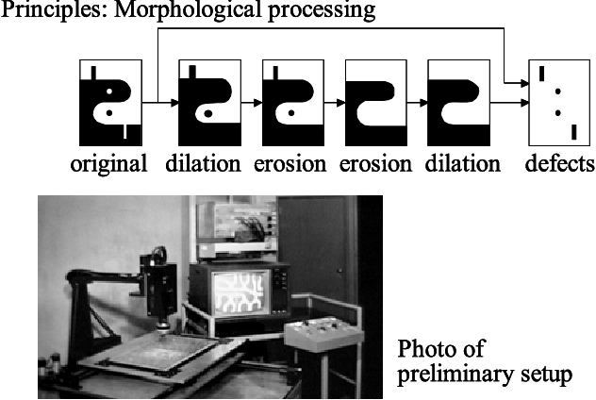
HISTORY | Early Machine Vision
Morphological processing concept
1983

Slide 7
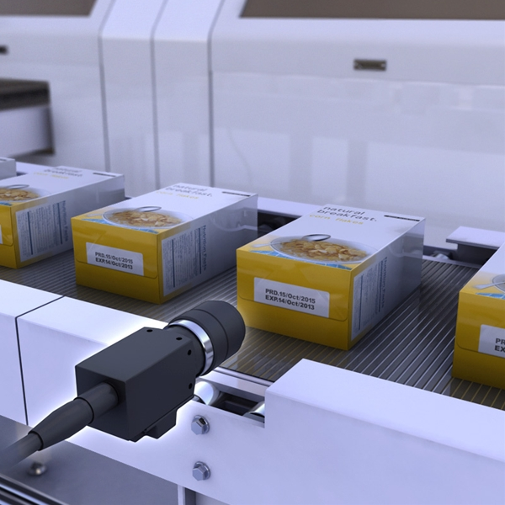
HISTORY | Classical Machine Vision
Processing requirements reduced and standardized
PCI frame grabber cards
USB 2.0/3.0
GigE Vision
Expensive
Well conditioned environment
Sensitive to variations
Algorithms:
Morphological processing concept
Template matching

Slide 8
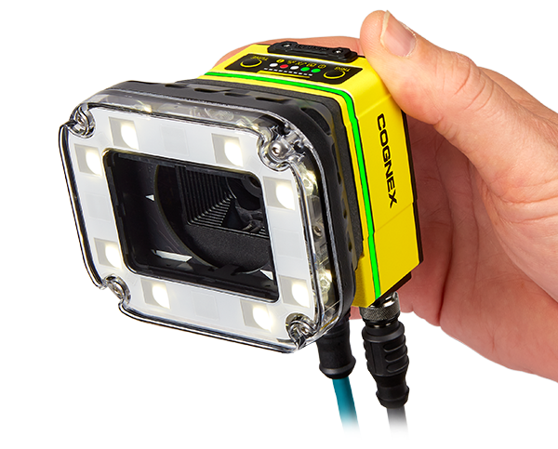
HISTORY | Machine Vision Today
Software has become crucial
Reduce centralized processing
Smart cameras: HW + SW
Integrated lighting
Sensitive to product variations
Algorithms:
Morphological processing concept
Template matching

Slide 9
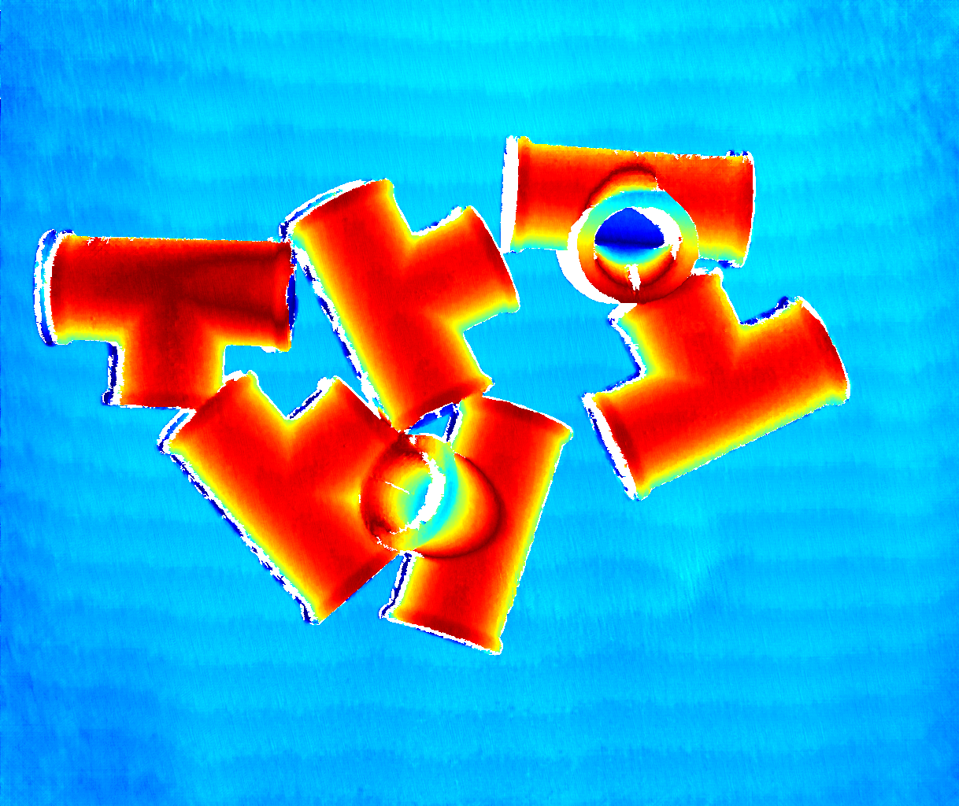
HISTORY | Machine Vision Today
3D Technologies:
Multi Camera Stereoscopie
Structural light
Sheet of light
Time of flight
Integrated Illumination
Requires heavy processing
Sensitive to product variations
Algorithms:
Morphological processing concept
Template matching

Slide 10
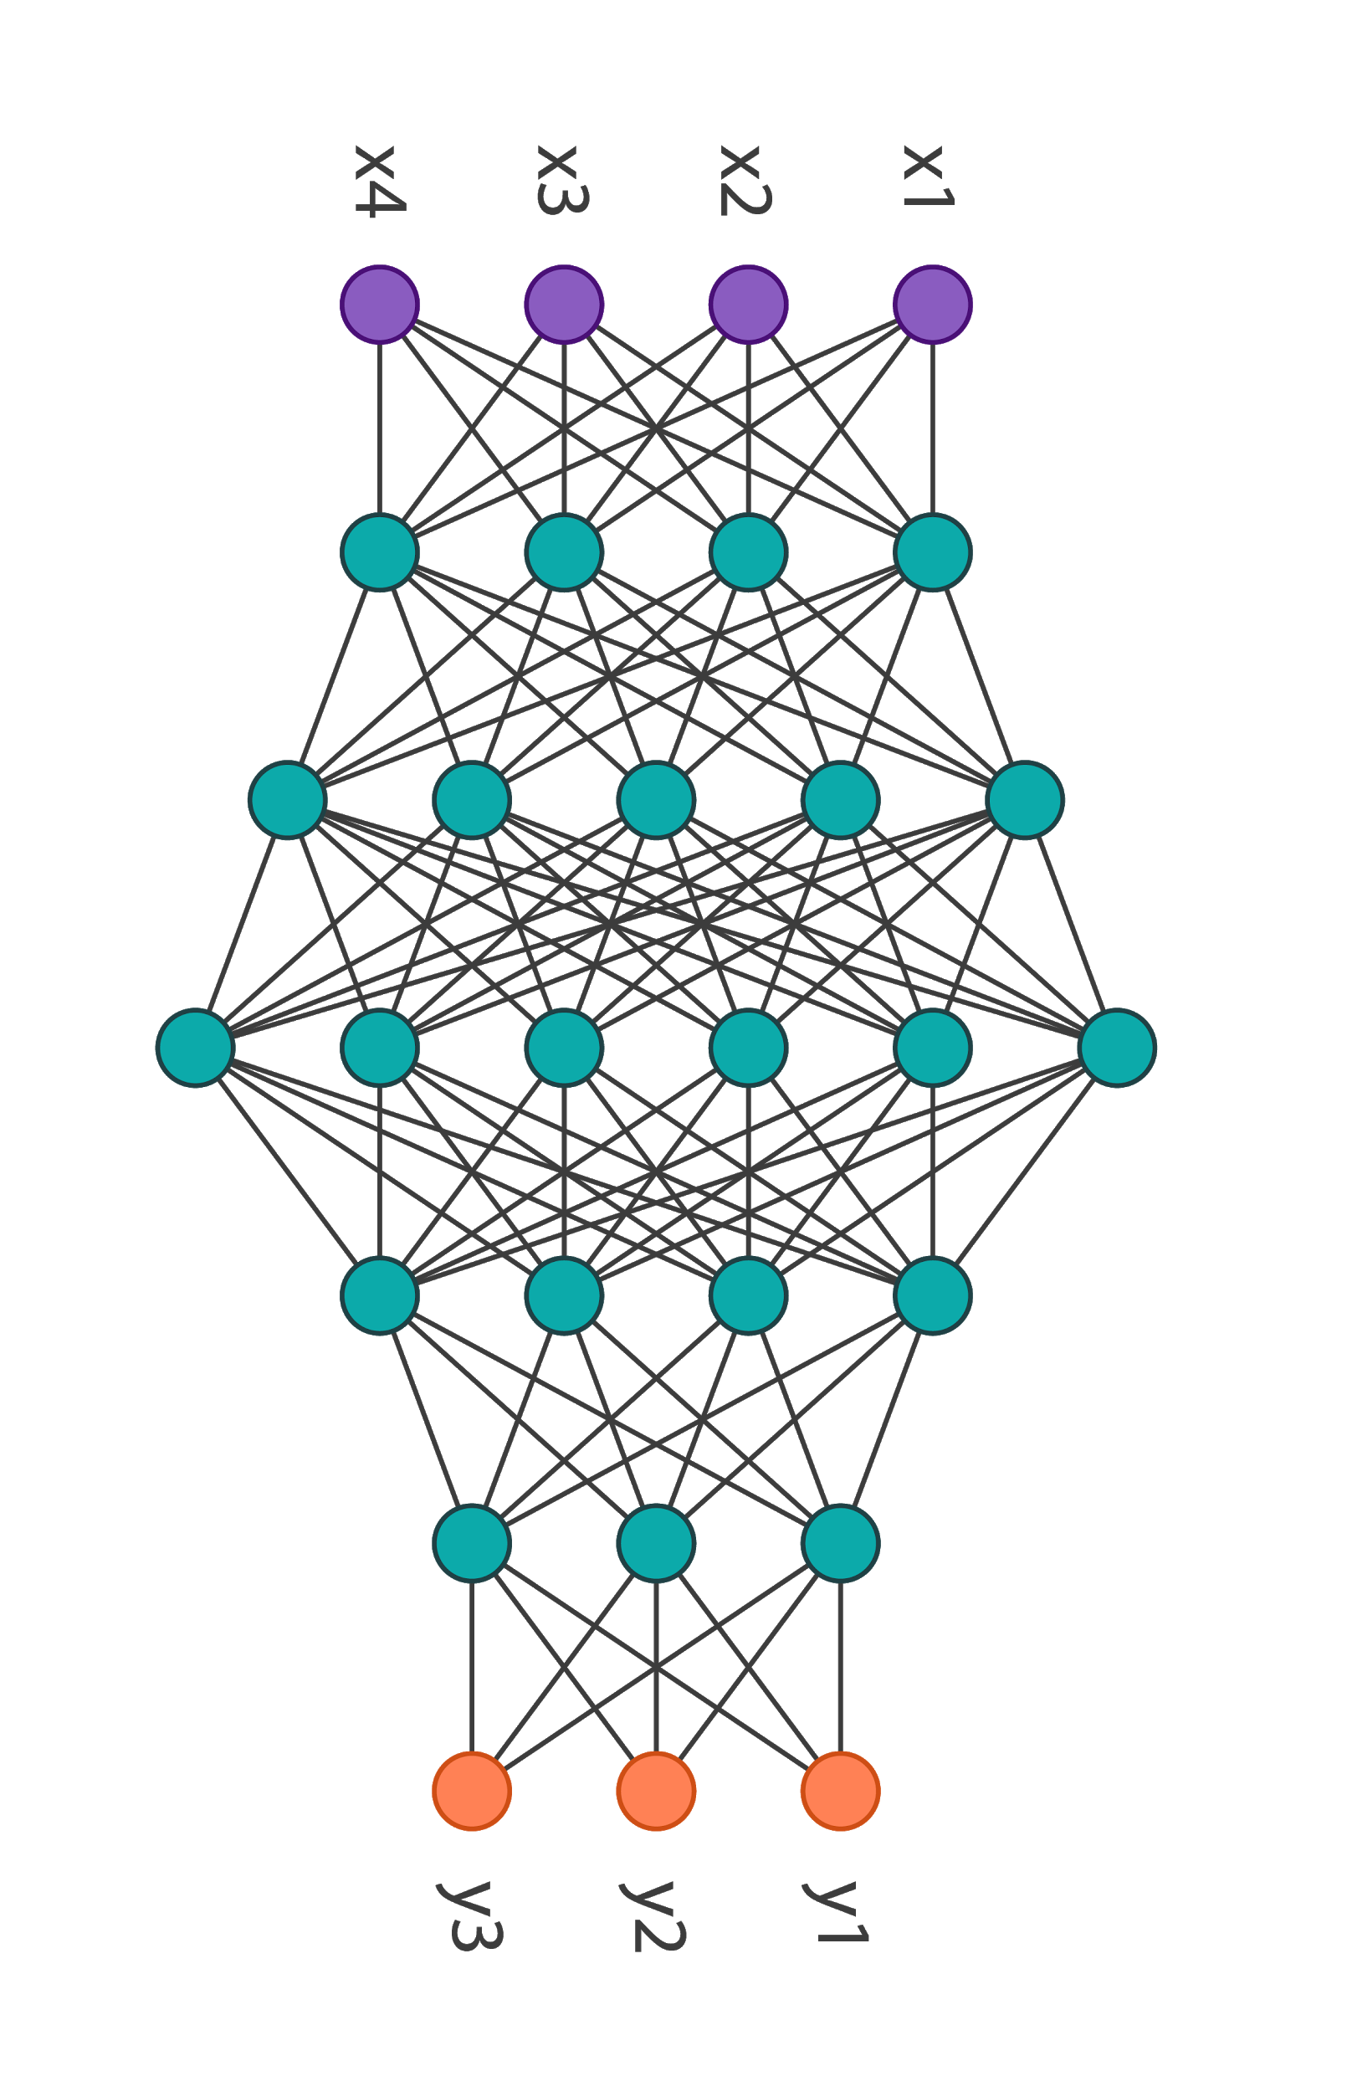
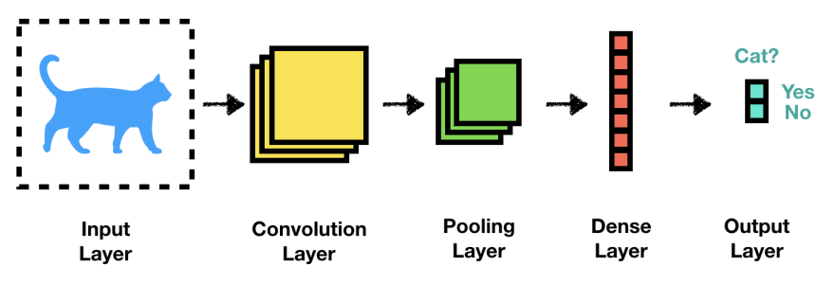
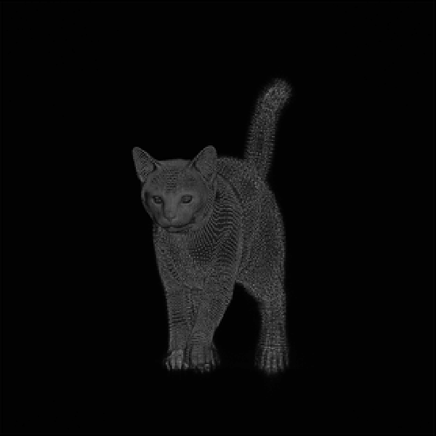
ADVANCED | Vision Technology Tomorrow
Powered by advances in CV:
More powerful and accessible processing hardware (GPU, FPGA)
Efficient Machine Learning
More robust against variations
Algorithms:
Neural Networks
(e.g. Deep Learning)

Slide 13
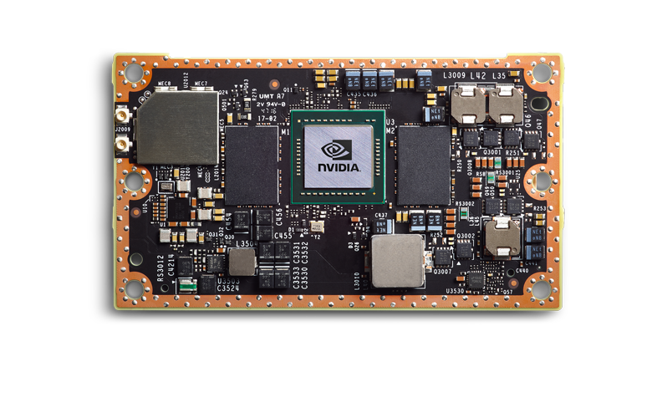
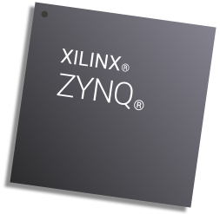
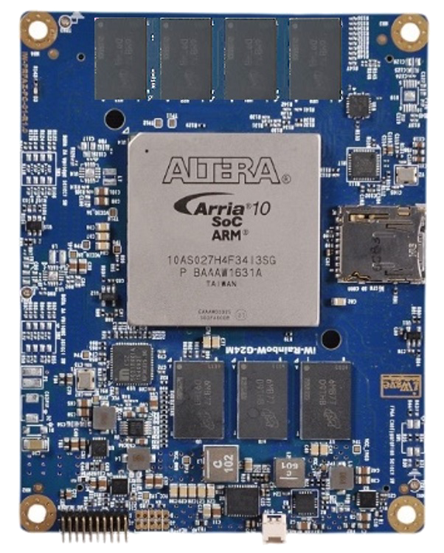
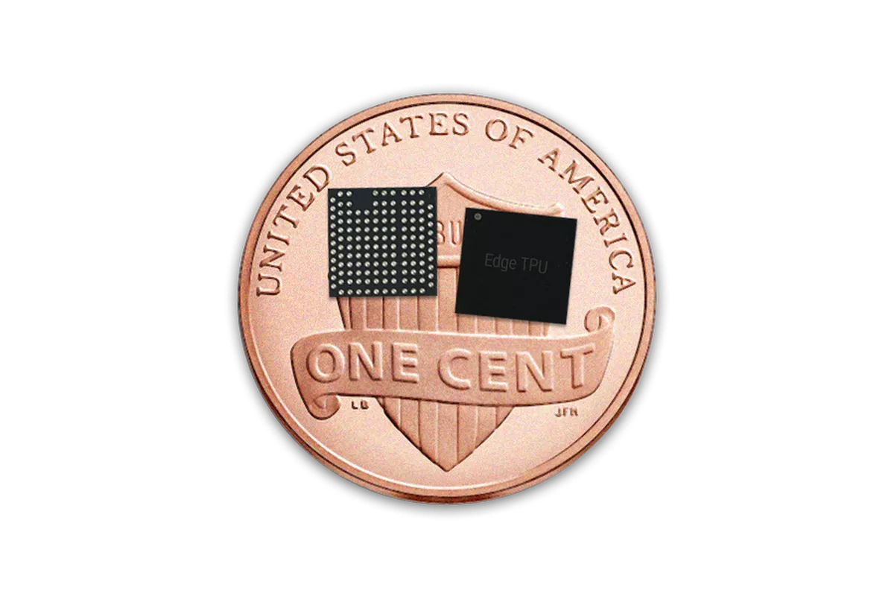
ADVANCED | Vision Technology Tomorrow
Embedded!
Power efficiency
Distributed computing
Reduced data bandwidth
New generation of
“smart cameras”

Slide 14
Thanks for your attention!

