Slide 2
Counting packaging straps
ArcelorMittal
Stijn Debecker

Slide 3
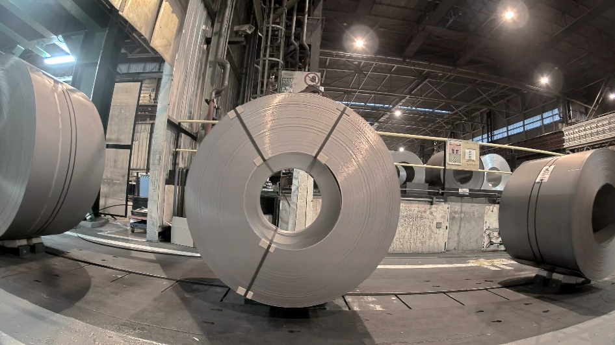
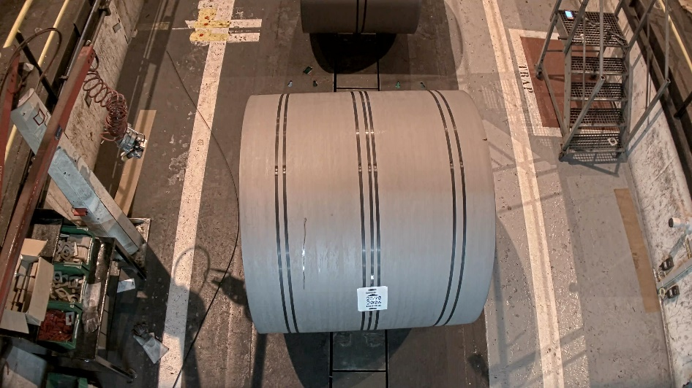
Counting Straps
Straps hold coils together
Customers can request a certain packaging
Operators make errors
Goal: Assist operators with strap counting

Slide 4
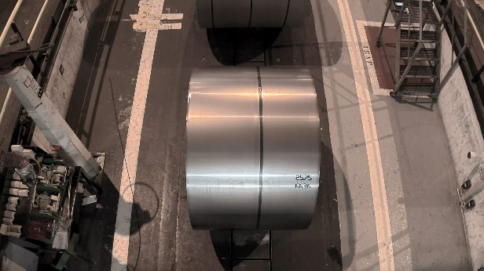
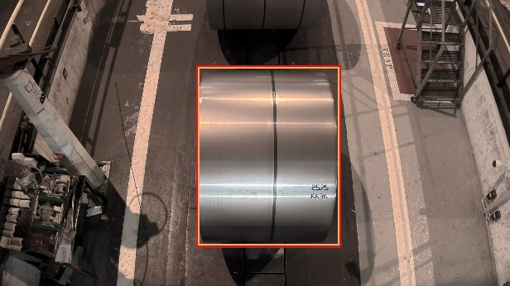
AI solution
Photo
Detect
Crop
Count
Straps: 1
Repeat for eye straps
Notes:
AI makes our conventional cameras smart and gives us the possibility to improve safety, automatization and maintenance applications

Slide 5
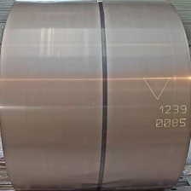
Why AI?
Rule based image processing?
Thresholding:
- Take into account all pixels with high enough intensity
- Dark pixels remain

Slide 7
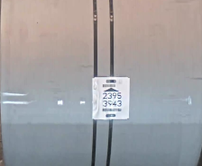

Slide 9
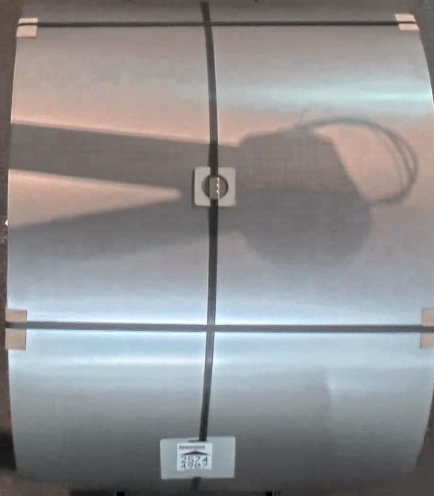
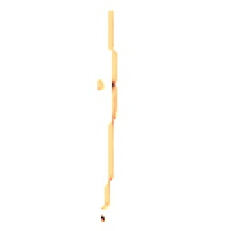
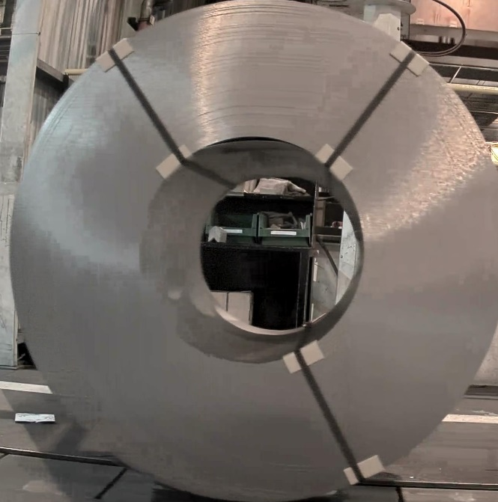
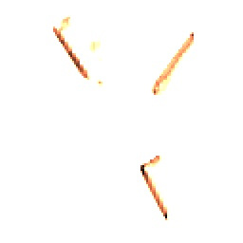
Why AI?
AI is more robust
Requires enough data!

Slide 10
Training and implementation
Libraries: OpenCv , Tensorflow
Collection of 5000 coil images for training
Training on a pc with a GPU => python
During production the model runs on a server (without GPU) => c#

Slide 11
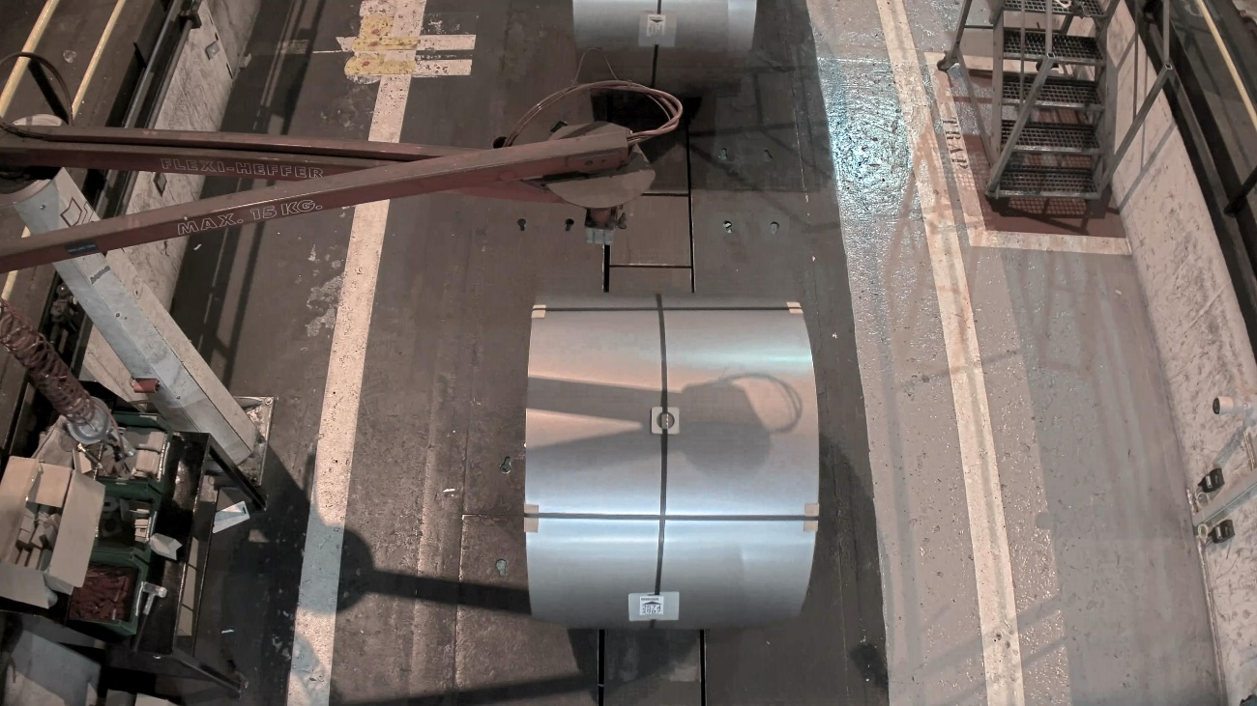
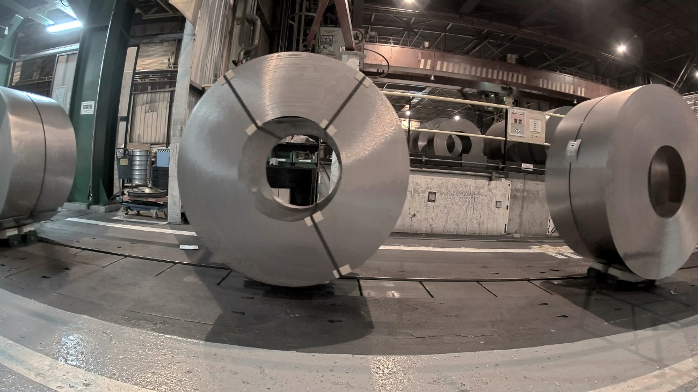
Status
From PLC/PRC
Take photo
1 surface strap
3 eye straps
Coil Vision
To PRC
1 surface strap
3 eye straps
To Prc/PLC
1
3

Slide 12
Status
Implemented at one pilot line => running for 3 months
>99% accuracy
Coming months roll out on other lines
Hardware study

Slide 13
Lessons learned
Data is VERY important
More data is better
Enough variation
Annotating images is very time consuming
Make people familiar with this technology
Roll out to production is a difficult exercise

Slide 14
Thank you for your attention!
stijn.debecker@arcelormittal.com
stijn.bogaert@arcelormittal.com

