Slide 2
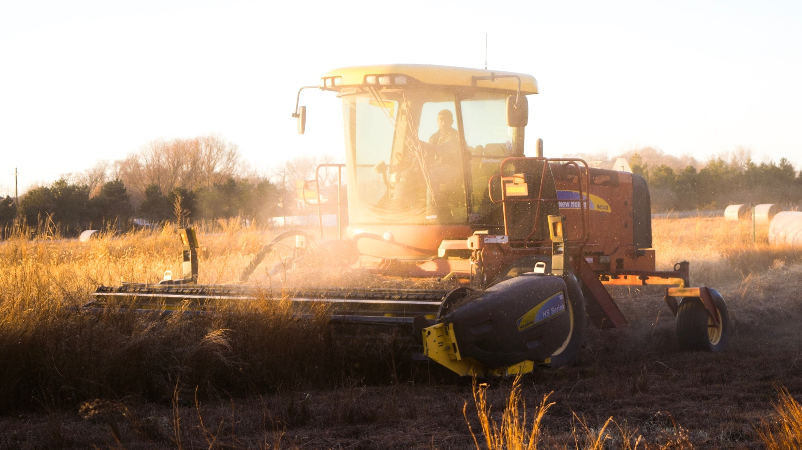
Smart Graincam
CNH Industrial
Paul Snauwaert

Slide 3
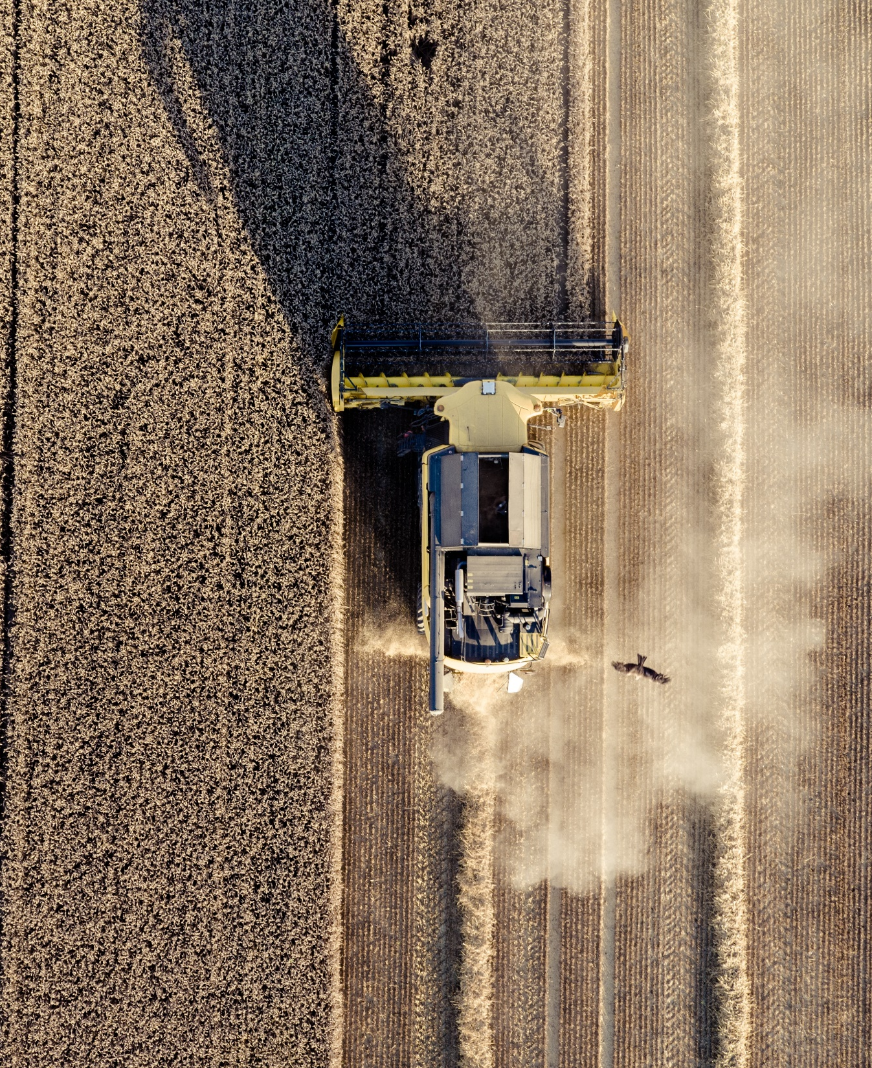
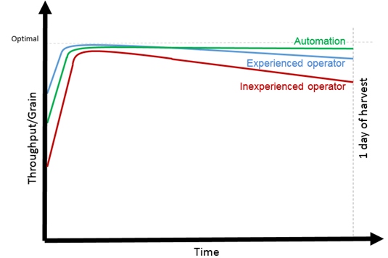
CNHi STRATEGY: Fully automated combines
END GOAL OF THE GRAIN CAM PROJECT
Automatically adjust the functional parameters of the combine
EXPECTED RESULT
Maximized throughput
Frees up time for the operator to focus on other things (e.g. unload on the go, mapping, feeding, harvest management …)
Results in stress free harvesting
Makes it easier to find operators

Slide 4
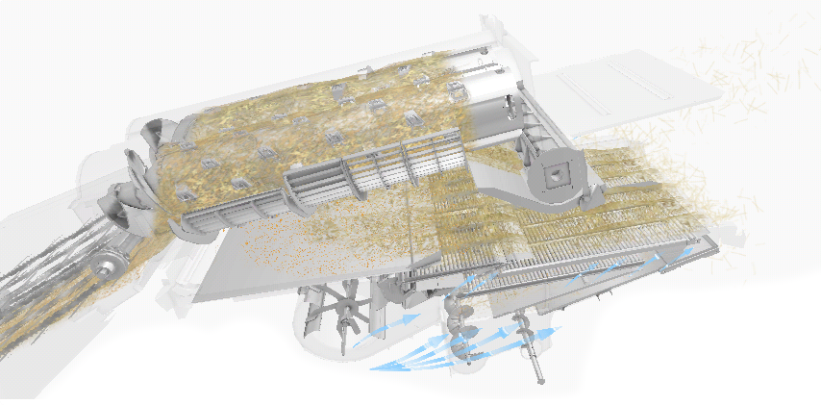
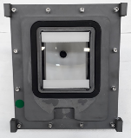
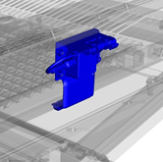
CNHi STRATEGY: Fully automated combines
Challenge
Sense the internal state of the combine process, e.g. grainquality
Rotor vanes angle
22” models only
Yield and moisture
Graincam
Engine load
Feed rate sensor
Rotor loss
Sieve loss
Sieve load
Inclination sensors
Returns volume

Slide 5
SMART GRAIN CAM: The current state
Camera
A multispectral camera
Goal
Assess grain-sample quality

Slide 6
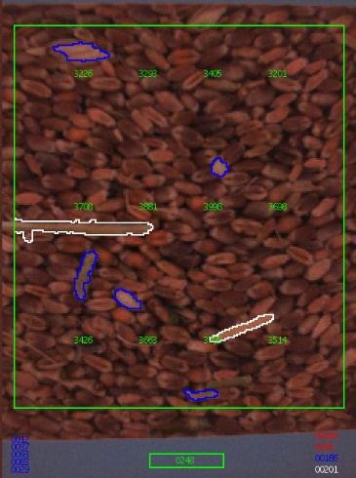
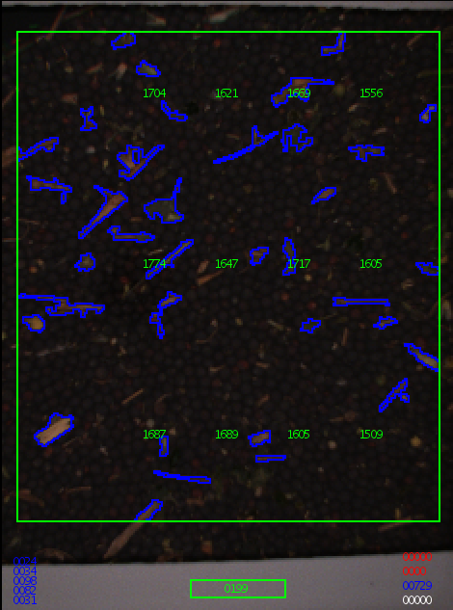
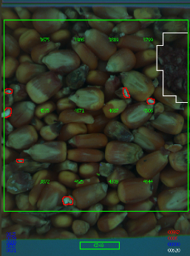
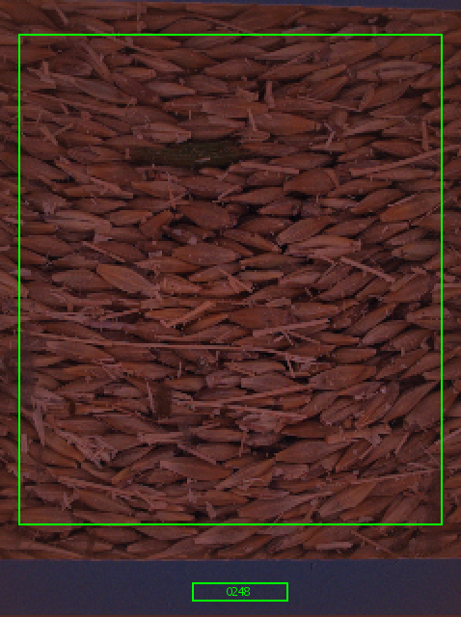
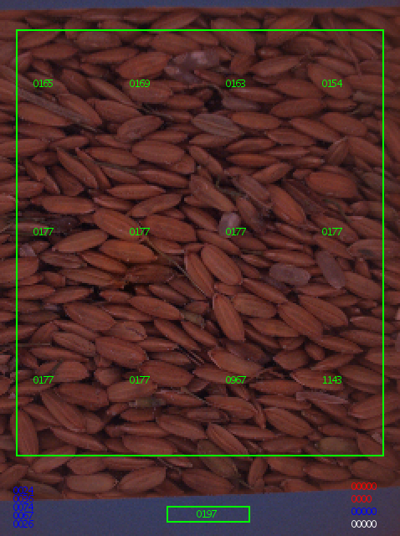
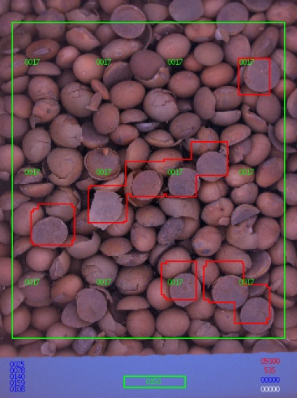
SMART GRAIN CAM: The current state
Challenges
Creating & tuning algorithms able to identify impurities in a wide variety of crops – varieties – conditions
Barley
Rice
Wheat
Canola
Corn
Soybeans
?
Developed and tuned using state of the art image processing techniques
+ many others (sunflower, oats , grass seed, peas, ….)

Slide 7
PROJECT SMART GRAINCAM: Deep learning powered Grain Cam
Limitations of current Grain Cam
The previously used state-of-the-art image processing techniques took long development time
Small set of images (not representative)
Basic algorithm
More images are being collected
A lot of effort needed to update / improve the algorithm
Limited complexity
Canola → straight forward
Broken kernels –> extremely challenging
Reasons to switch to AI
Non-safety critical
Making a mistake is not such a problem
Not necessary to understand why the algorithm is detecting certain features
Shorter iteration times
Key is the creation of a database of images including enough variability and labeling them
Retraining if a new situation has been encountered
More complex features can be identified
Features that state of the art image processing techniques could never detect

Slide 8
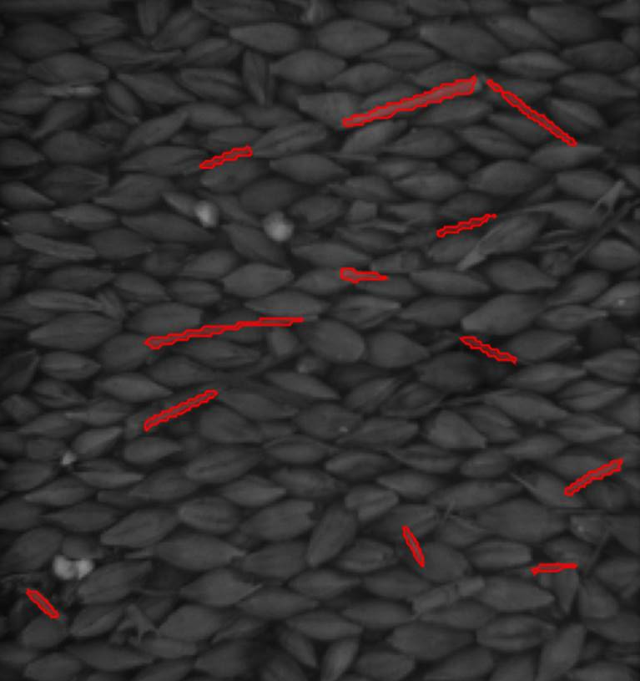
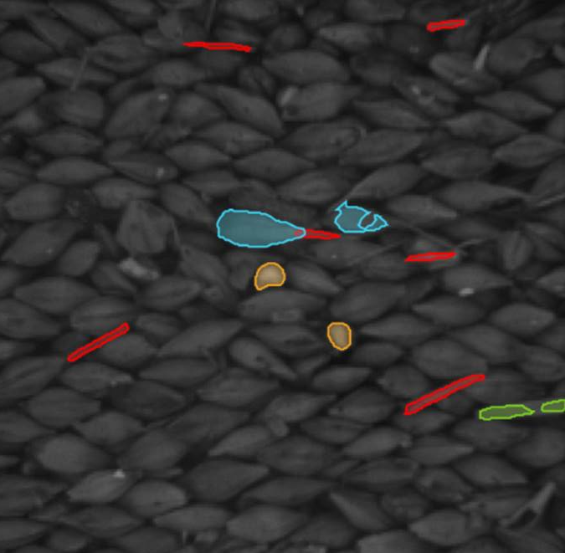
PROJECT SMART GRAINCAM: Deep learning powered Grain Cam
PROOF OF CONCEPT
Demonstrate the power of AI on the barley use-case
PHASE 1
PHASE 2
PHASE 3
Develop a Barley model that can identify needles
Develop a Barley model that can identify needles, straw, broken kernels, needles attached to kernels
Optimize model to run on existing Grain Cam platform, i.e. freescale IMX6 quad core without powerful GPU, in under 4 sec

Slide 9
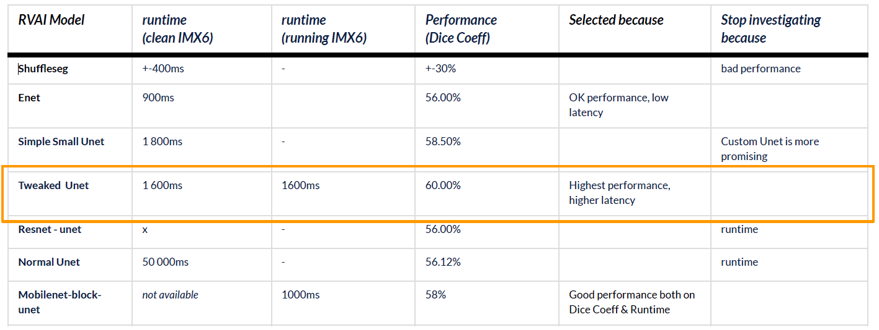
PROJECT SMART GRAINCAM: Deep learning powered Grain Cam
RESULTS
Multiple models created each with their own strengths & weaknesses
PHASE 1
PHASE 2
PHASE 3
The selected model was optimized to run on the IMX6 Platform

Slide 10
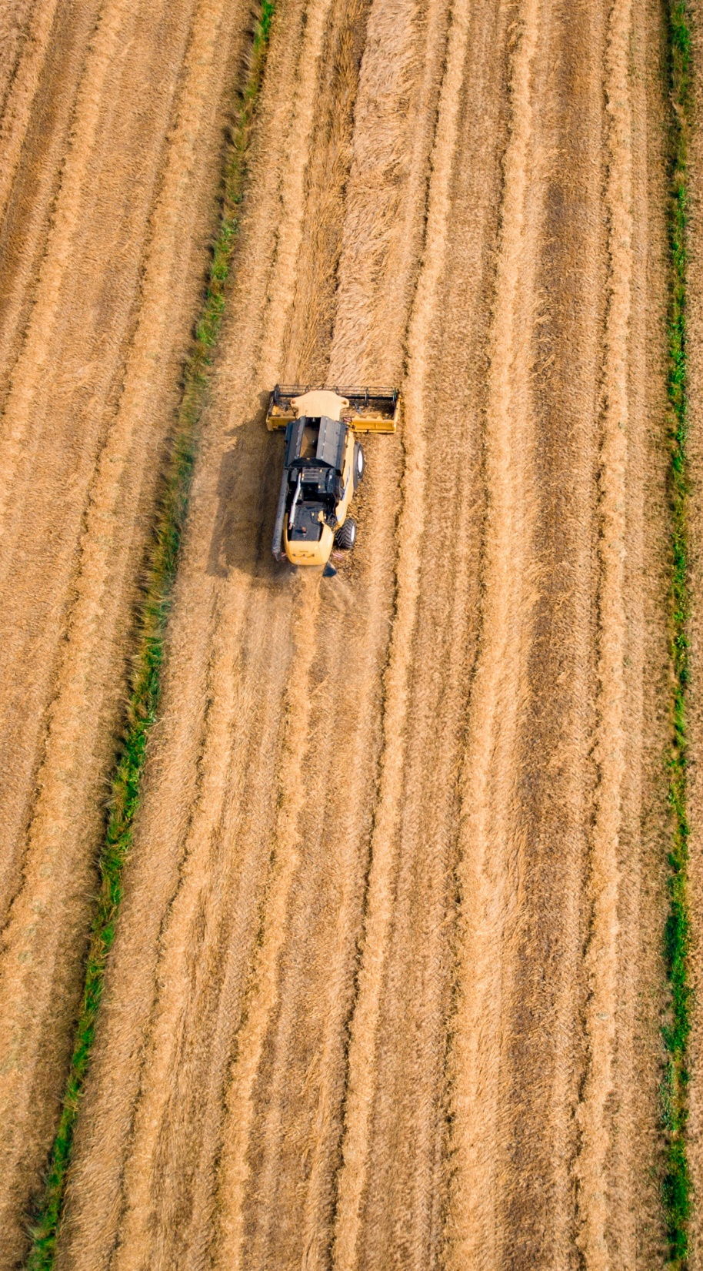
PROJECT SMART GRAINCAM: Learnings & next steps
AI methodology is 100% suited for this type of application
Current effort is focused too much on optimizing the networks for a sub optimal run time environment
LEARNINGS
Finish Barley use case on existing platform
Identify future proof platform
GPU´s vs FPGA
NEXT STEPS

