Slide 2
Data-efficient optimization of 3D printing jobs
Joeri Ruyssinck

Slide 3
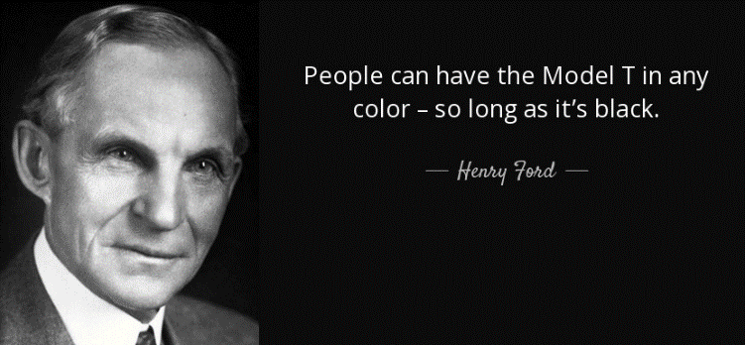
Henry Ford’s production line 1913

Slide 4
Production line 2019
…not that much has changed

Slide 5
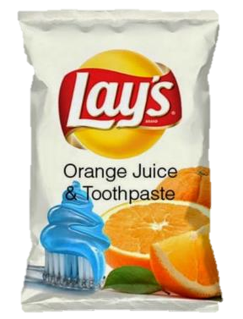
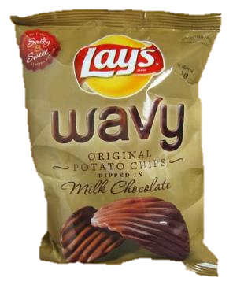
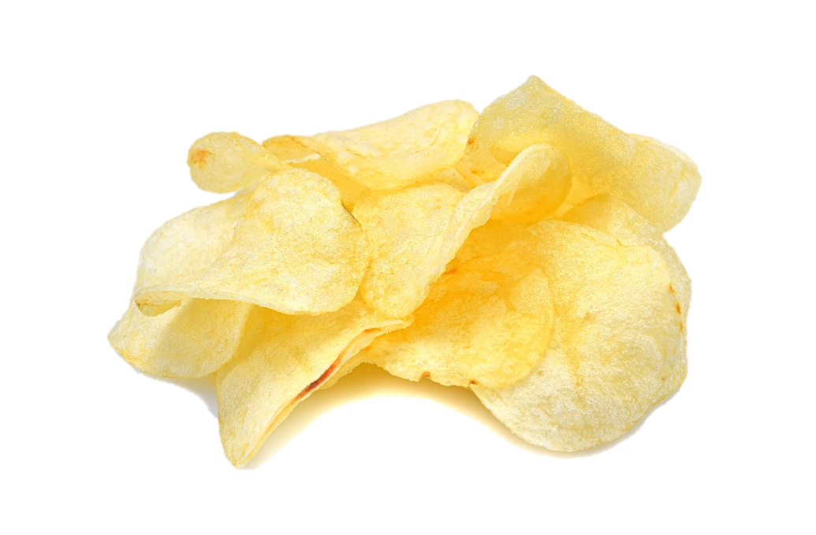
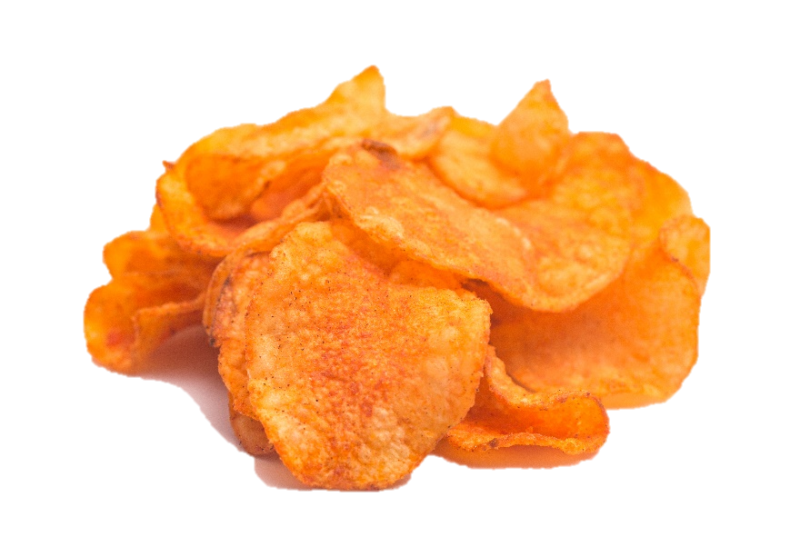
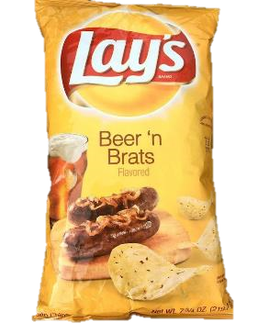
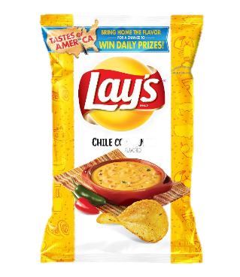
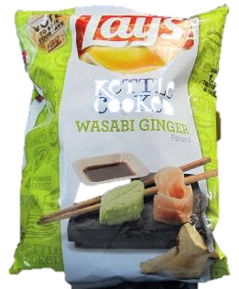
The customer has changed

Slide 6
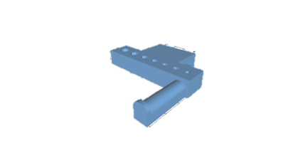
Context
3D printing is a flexible technology allowing for more versatility and faster changeovers in modern manufacturing
Business value
3D positioning during printing has an effect on Price & Quality Can we optimize this positioning for an arbitrary object?
Tools available
A black box simulator is available to provide feedback when provided with objects and specified orientations
$f\left(θ,φ\right)→ \left\{\begin{aligned}Price \\ Quality\end{aligned}\right.$

Slide 7
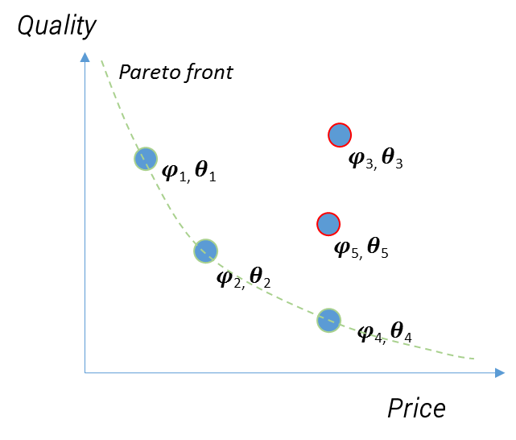
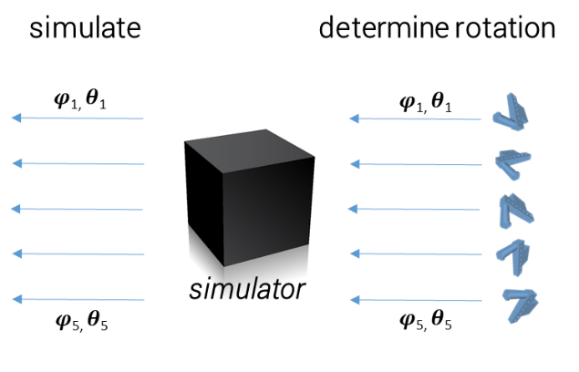
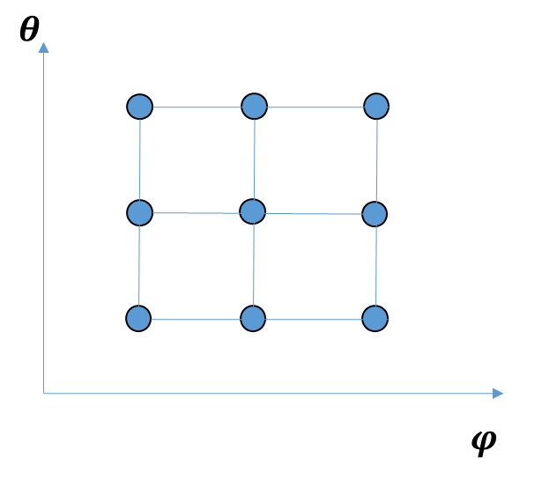
Non-AI approach
Typical workflow
grid search (or RS, GA)
Why doesn’t it work?
The simulator is computationally too expensive too have sufficient exploration

Slide 8
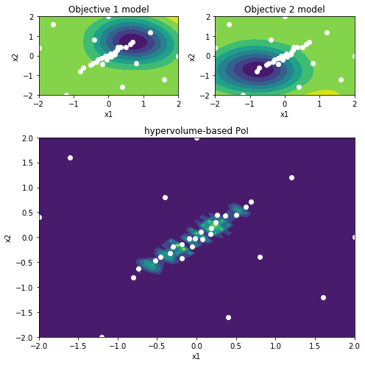
AI Solution
Multi-objective Bayesian Optimization
Why does it work?
AI models the parameter space and can suggest ‘intelligently’ the next points to simulate
Commercially available as a service offered by several companies (e.g. SigOpt), but limited usability…

Slide 9
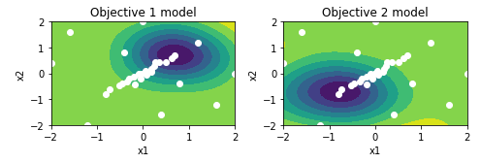
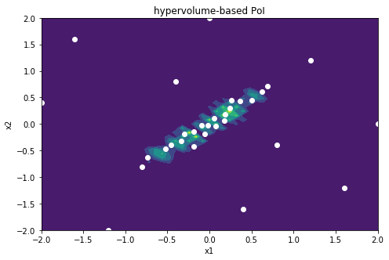
Multi-objective Bayesian Optimization
Each dot represent a single simulation
Dark green zones indicate higher value
Simulations are clustered around the interesting regions
Suggest new simulations
Update landscape
“Probability of Improvement”
Trade-off between exploration and exploitation
Can reduce amount of simulations by factor 10 or 100

Slide 10
Challenges
“AI products rarely cover the business needs”
Commercially available
Scientific literature
ML2Grow’s solution
✔️
✔️
✔️
Bayesian optimization
Bayesian optimization API
✔️
X
✔️
Multiple objectives
~
✔️
✔️
Multi-fidelity support
X
~
✔️
X
~
✔️
Reweighing objective functions
Kickstart optimization procedure
X
X
✔️

Slide 11
Creating value
REST API
A -> S(lides)
Looks nice
A -> Z
Business value
No notebooks allowed
(in the last phase)

Slide 12
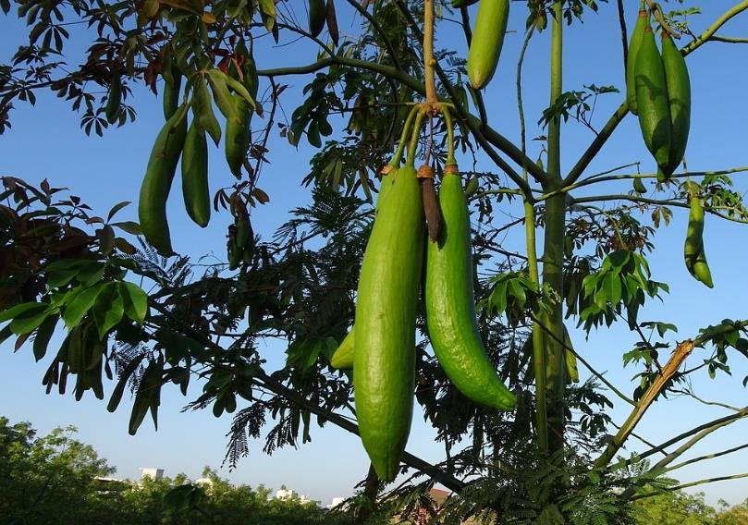
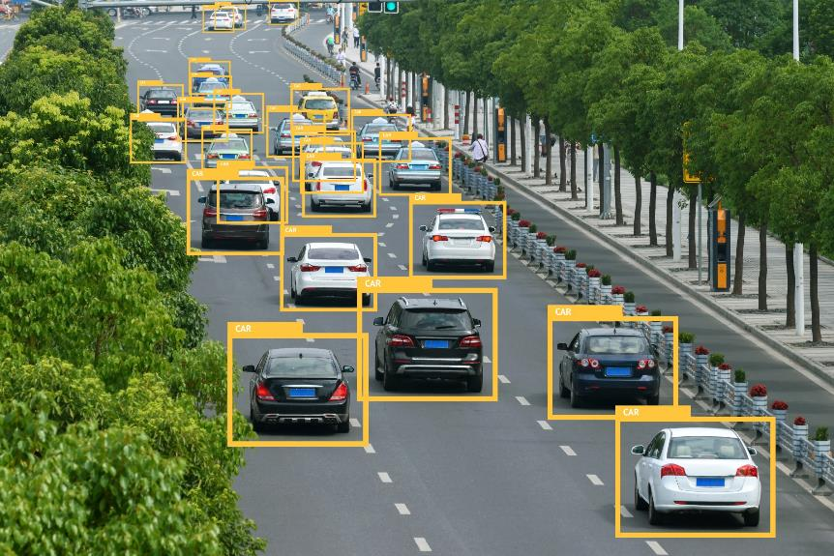
More applications
… beyond optimizing traditional (CFD) simulations
Yield condition optimization
Hypertuning of deep neural networks

Slide 13
Get in touch!

