Slide 1
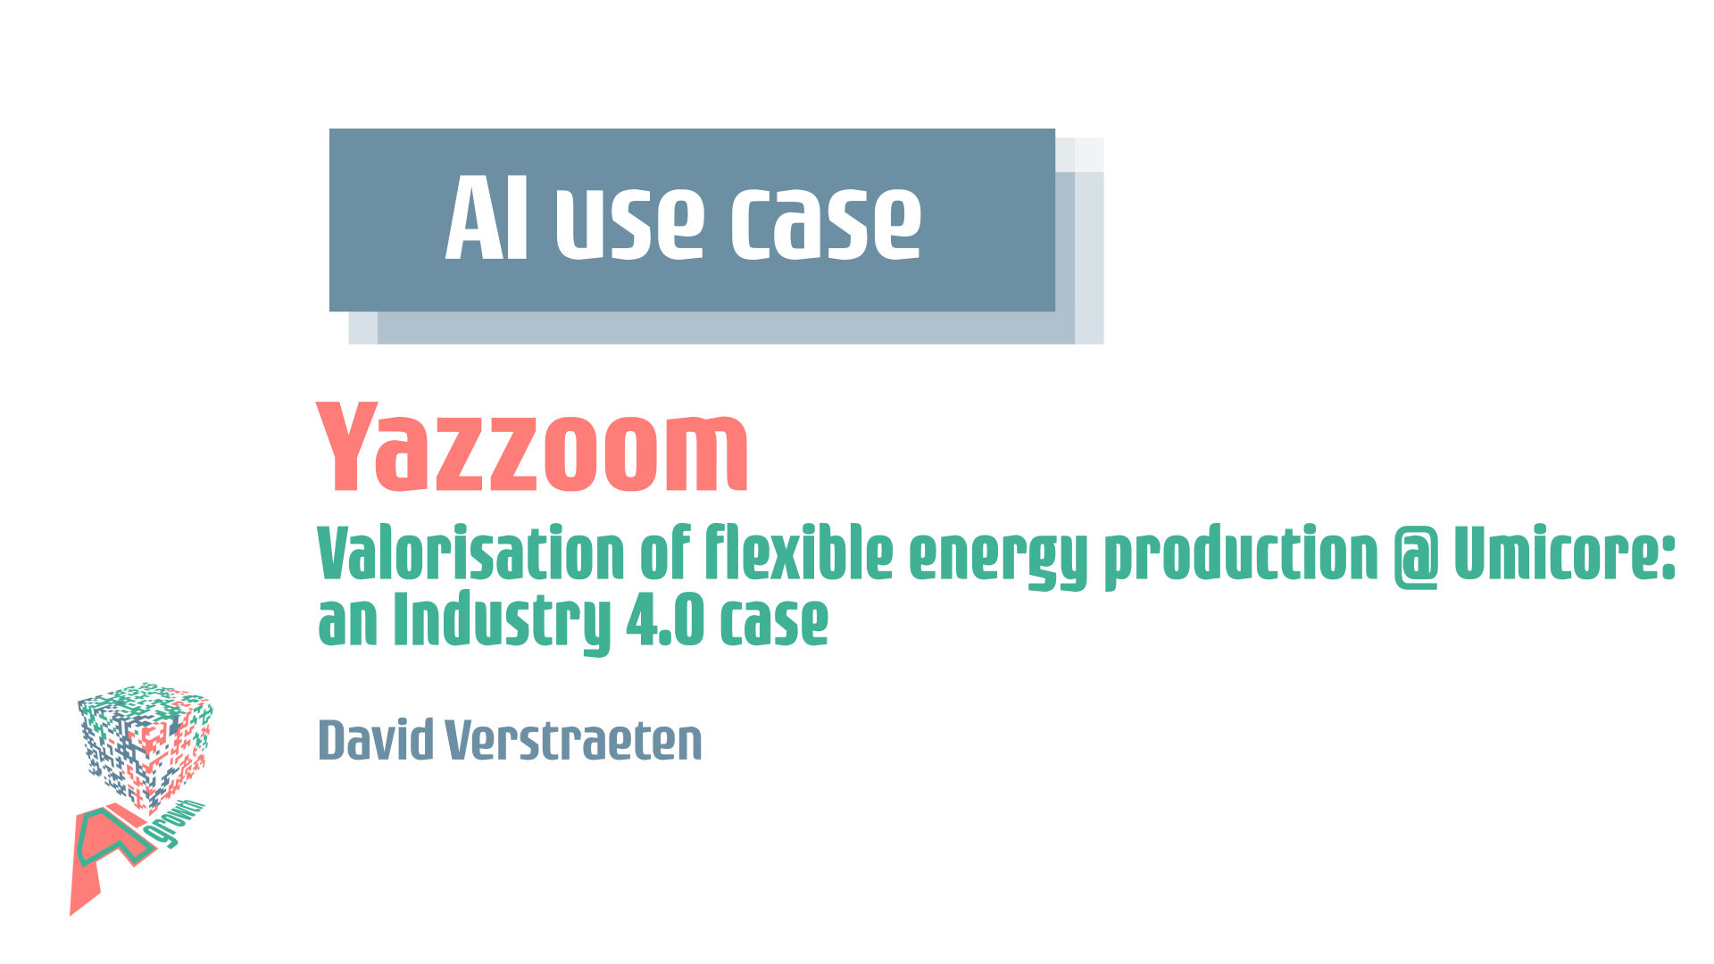

Slide 2

Valorisation of flexible energy production @ Umicore: an Industry 4.0 case
David Verstraeten – Partner, engineering manager

Slide 3










The intraday imbalance market
    Electricity prices are very volatile
    Electricity is by nature hard to store and must be available depending on demand
    Network operator (Elia) uses pricing mechanism to stimulate producers to create balance on the network
    Production and consumption have to be balanced in real time
    Production needs need to be filled
    Continuous Intraday Market
    How to optimally choose when to buy, sell or produce.
creating value from data

Slide 4
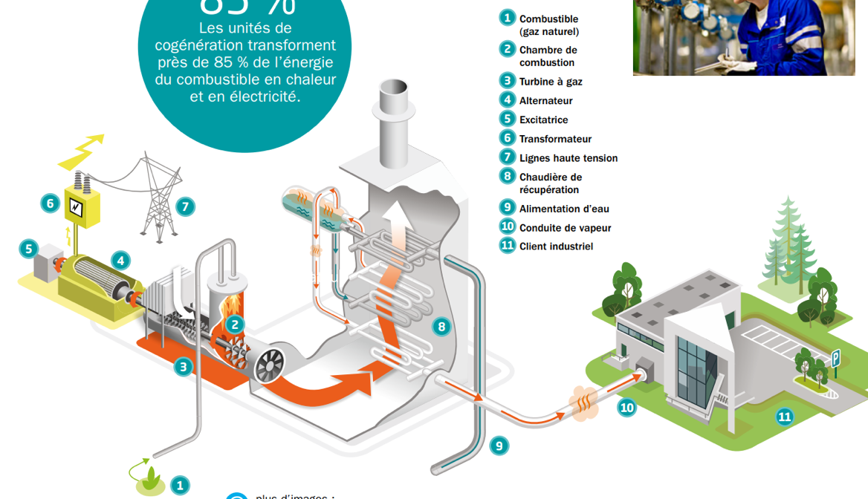
Combined Heat and Power (CHP): the principle
Natural gas
Combustion
chamber
Gas turbine
Alternator
Exciter
Transformer
High voltage lines
Heat recovery
steam generator
Water feed
Produced steam
Production plant
creating value from data

Slide 5
Phased approach
Phase 0: Predictive modeling
  Price prediction model for intra-day electricity market running on AWS
Phase 1: Advanced Regulatory Process Control
  Audit and improvement of pressure control → reduction of oscillations, improved dynamic response
Phase 2: Supervisory Control without electricity price predictions
  Switch to load control : On-site server overrules output of pressure controllers to control production output
Phase 3: Supervisory Control: RTO with price predictions
  On-site server reads price predictions from the cloud and performs real-time optimization to decide which production units produce how much
creating value from data

Slide 6
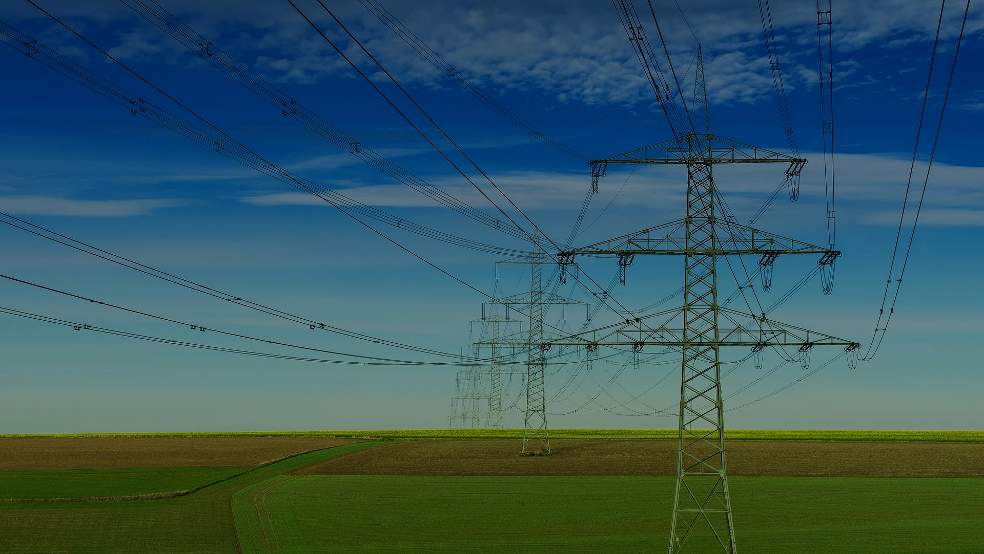









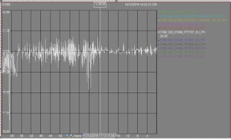




Price of gas next 24h
Historical Electricity data
Public Data
Electrical Network Manager Data
Predictive Modeling
Price of Electricity
in 15 Min.
Production Data (Historian)
Data and Properties of Energy Supply Units
Modeling (Predictive, “White Box”, System Dynamics …)
Advanced Process Control
Optimal Control (Yield, Flexibility) of Energy Supply Units under Constraint of Production Demands
Real Time Optimization of CHP Energy Production
Optimization Algorithms
Energy Supply and Production Units Supervisory Control
Production Energy Demands
creating value from data

Slide 7

Lessons learned
A true Industry 4.0 case: cloud connectivity, predictive modeling, optimisation and realtime control of assets
Phased approach is important
Close collaboration between 4 essential partners: Umicore, Yazzoom, Agidens and Power-Pulse
creating value from data

Slide 8

Other Industry 4.0 cases
Energy management platform (incl. imbalace steering) for oil&gas multinational
AI-based anomaly detection on various industrial production lines and machines → Yanomaly
Prediction of unplanned stops and root cause analysis on automatic manufacturing line
Virtual sensors incl. process control for various customers in paper/pulp
creating value from data

