Slide 2
AI4Growth
IoT & Manufacturing
Quality Optimization &
Predictive Maintenance

Slide 3
Breght Van Baelen
AI Competence Lead
breght.vanbaelen@cegeka.com

Slide 4
Background
Client produces material solutions with a kiln
Material solutions: cement, sand,…
Kiln: large-scale industrial oven
Notes:
We are going to explain QO & PM based on a real life project we did for a client. Our client here is a material solutions company who wants to replace a kiln.
A client of ours, a global material solutions company wants to build a new kiln based on an existing one. A kiln is a large-scale industrial oven that reaches incredible temperatures to refine sand. The existing kiln suffers from 2 drawbacks, namely quality loss in the output product and defects leading to downtime. They asked Cegeka to use data from the existing kiln and improve the quality and uptime for the new kiln.

Slide 5
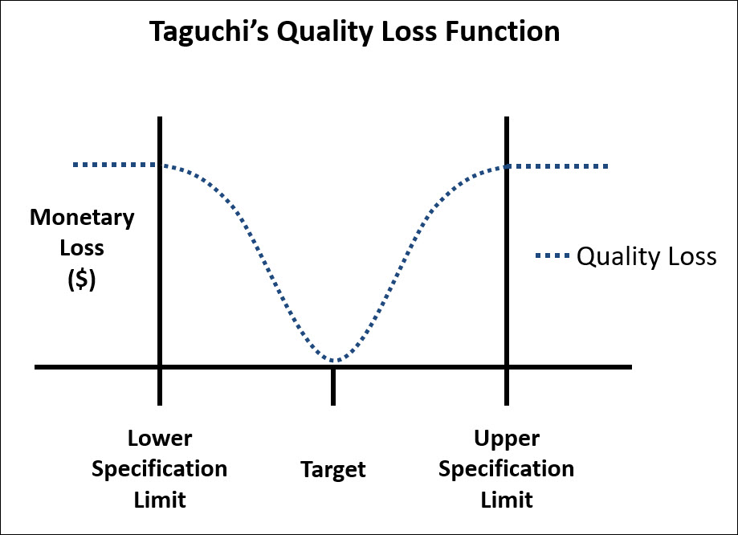
Pain
Existing kiln suffers from large production costs
Quality loss
Notes:
A client of ours, a global material solutions company wants to build a new kiln based on an existing one. A kiln is a large-scale industrial oven that reaches incredible temperatures to refine sand. The existing kiln suffers from 2 drawbacks, namely quality loss in the output product and defects leading to downtime. They asked Cegeka to use data from the existing kiln and improve the quality and uptime for the new kiln.
-waarom aan predictive maintenance gaan doen?

Slide 6
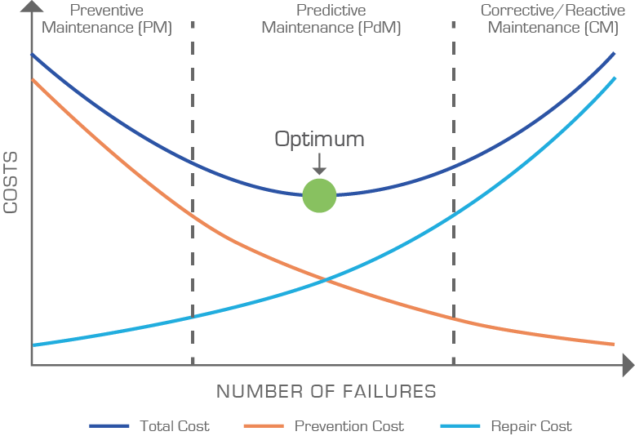
Pain
Existing kiln suffers from large production costs
Quality loss
Maintenance
Notes:
A client of ours, a global material solutions company wants to build a new kiln based on an existing one. A kiln is a large-scale industrial oven that reaches incredible temperatures to refine sand. The existing kiln suffers from 2 drawbacks, namely quality loss in the output product and defects leading to downtime. They asked Cegeka to use data from the existing kiln and improve the quality and uptime for the new kiln.
-waarom aan predictive maintenance gaan doen?

Slide 7
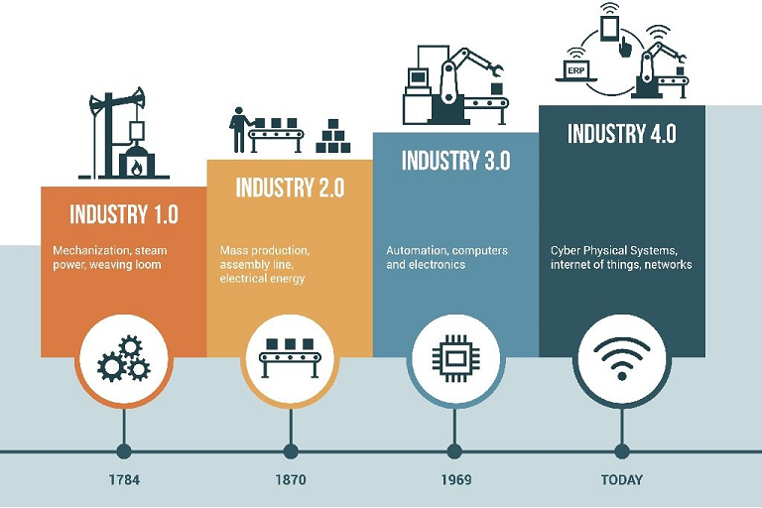
Solution & Gain
Build a more performant kiln using data from existing kiln
Optimize quality
Predict maintenance
Gain: production cost reduction
Notes:
A client of ours, a global material solutions company wants to build a new kiln based on an existing one. A kiln is a large-scale industrial oven that reaches incredible temperatures to refine sand. The existing kiln suffers from 2 drawbacks, namely quality loss in the output product and defects leading to downtime. They asked Cegeka to use data from the existing kiln and improve the quality and uptime for the new kiln.
-waarom aan predictive maintenance gaan doen?

Slide 8
Provided Data

Slide 9
Sensor & Quality Data
Historic sensor data
HISTORICAL TAGNAME | P&IDTAGNAME | ADDITIONAL INFO | ALARM LOWLOW | ALARM LOW | ALARM HIGH | ALARM HIGHHIGH
REDUN_011 | 320-200 TIRBT 08 | (0-300C) |  |  | 75 | 250
REDUN_012 | 320-200 TIRBT 09 | (0-300C) |  |  | 75 | 80
REDUN_013 | 320-200 TIRBT 10 | (0-300C) |  |  | 75 | 80
REDUN_014 | 320-200 TIRBT 11 | (0-300C) |  |  | 75 | 90
REDUN_015 | 320-200 TIRBT 12 | (0-300C) |  |  | 75 | 80
REDUN_016 | 320-200 TIRBT 13 | (0-300C) | 390 | 880
REDUN_017 | 320-200 TIRBT 14 | (0-3999NM3/H) | 400 | 900
REDUN_018 | 320-200 TIRBT 15 | (0-13999NM3/H) |  |  | 400 | 500
REDUN_019 | 320-200 TIRBT 16 | (0-1200C) |  |  | 500 | 600
REDUN_020 | 320-200 TIRBT 17 | (-100-400C) |  |  | 600 | 700
REDUN_021 | 320-200 TIRBT 18 | (0-5BAR)
REDUN_022 | 320-200 TIRBT 19 | (0-10BAR) |  | 40
REDUN_023 | 320-200 TIRBT 20 | (0-15BAR) |  | 50
Quality inspection results
DATE | HOUR | ITEM | DESCRIPTION | H/S | CODE | TYPE | STOCK | 600 | 500 | 400 | 300 | 200 | 100 | BAND | L* | A* | B* | BSPOT OCS | BSPOT OCS200 | BSPOT OCS300
02/04/2019 | 1:00:00 AM | 7576575 | HJGFKUYKFJKH | DS | 20190402BJHJVJHVJHV | FR | SILO6 | 0 | 0 | 0 | 435 | 457 | 54 | 0,1 | 55,85 | 0,03 | 0,54 | 0 | 0 | 1
03/04/2019 | 2:00:00 AM | 7576575 | HJGFKUYKFJKH | DS | 20190402BJHJVJHVJHV | FR | SILO7 | 0 | 0 | 233 | 6547 | 567 | 6 | 0,2 | 97,86 | 0,03 | 0,8 | 0 | 1 | 0
04/04/2019 | 3:00:00 AM | 7576575 | HJGFKUYKFJKH | DS | 20190402BJHJVJHVJHV | FR | SILO8 | 0 | 0 | 5 | 58 | 6876 | 5 | 0,3 | 97,87 | 0,03 | 0 | 1 | 1 | 1
05/04/2019 | 4:00:00 AM | 7576575 | HJGFKUYKFJKH | DS | 20190402BJHJVJHVJHV | FR | SILO9 | 0 | 0 | 5645 | 7689 | 4768 | 5 | 0,4 | 97,88 | 0,03 | 0 | 0 | 0 | 1
06/04/2019 | 5:00:00 AM | 7576575 | HJGFKUYKFJKH | DS | 20190402BJHJVJHVJHV | FR | SILO10 | 0 | 0 | 7657 | 9807 | 87658 | 45 | 0,5 | 97,89 | 0,03 | 1 | 0 | 0 | 1
07/04/2019 | 6:00:00 AM | 7576575 | HJGFKUYKFJKH | DS | 20190402BJHJVJHVJHV | FR | SILO11 | 0 | 0 | 87 | 5676 | 58 | 45 | 0,6 | 97,9 | 0,03 | 0,5 | 0 | 0 | 1
08/04/2019 | 7:00:00 AM | 7576575 | HJGFKUYKFJKH | DS | 20190402BJHJVJHVJHV | FR | SILO12 | 0 | 0 | 787 | 68 | 5678 | 6 | 0,7 | 97,91 | 0,03 | 1 | 1 | 0 | 1
09/04/2019 | 8:00:00 AM | 7576575 | HJGFKUYKFJKH | DS | 20190402BJHJVJHVJHV | FR | SILO13 | 0 | 0 | 46 | 78 | 7685 | 56 | 0,8 | 97,92 | 0,03 | 0,2 | 0 | 1 | 0
10/04/2019 | 9:00:00 AM | 7576575 | HJGFKUYKFJKH | DS | 20190402BJHJVJHVJHV | FR | SILO14 | 0 | 0 | 46 | 577 | 8758 | 0 | 0,9 | 97,93 | 0,03 | 0,9 | 1 | 0 | 0
11/04/2019 | 10:00:00 AM | 7576575 | HJGFKUYKFJKH | DS | 20190402BJHJVJHVJHV | FR | SILO15 | 0 | 0 | 767 | 8 | 87685 | 65 | 1 | 97,94 | 0,03 | 0,9 | 0 | 1 | 0
12/04/2019 | 11:00:00 AM | 7576575 | HJGFKUYKFJKH | DS | 20190402BJHJVJHVJHV | FR | SILO16 | 0 | 0 | 748 | 7578 | 6765 | 9 | 1,1 | 97,95 | 0,03 | 0,8 | 1 | 1 | 1
Notes:
First we got historic sensor data to analyze when the production process needs maintenance and secondly we got quality inspection results to analyze what caused quality loss.

Slide 10
Deliverables

Slide 11
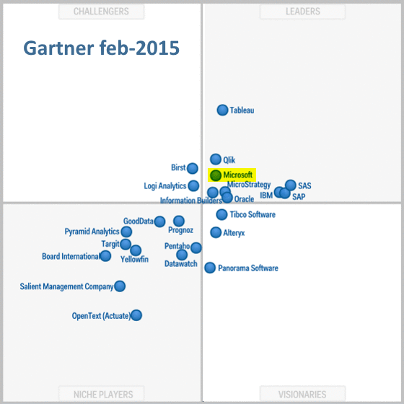
Reporting dashboard built with Microsoft Power BI
Notes:
First to get familiar with the data, we created a power bi report of the complete production process. PowerBI is the reporting tool from Microsoft. It is quit young but as seen from gartner has gained a lot of tracktion during the past years because of low entry fees and high flexibility

Slide 12
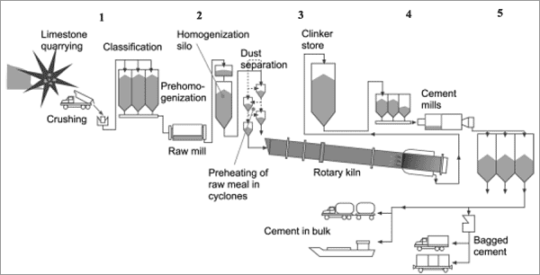
Reporting dashboard built with Microsoft Power BI
HISTORICAL TAGNAME | P&IDTAGNAME | DESCRIPTION | LOCATION A | ALARMTIME
REDUN_011 | 320-200 TIRBT 08 | LIMIT SWITCH | SPRAY | 100
REDUN_012 | 320-200 TIRBT 09 | LIMIT SWITCH | DRIVE | 120
REDUN_013 | 320-200 TIRBT 10 | LIMIT SWITCH | GEAR | 140
REDUN_014 | 320-200 TIRBT 11 | LIMIT SWITCH | GEAR | 150
REDUN_015 | 320-200 TIRBT 12 | SPEED CONTROL | SPRAY | 80
REDUN_016 | 320-200 TIRBT 13 | TEMP | DRIVE | 60
REDUN_017 | 320-200 TIRBT 14 | DRIVE | GEAR | 60
Notes:
This report proofed to be very useful for the process engineers because they could monitor the health of the each individual process part. For convenience we also added the flow sheet of the production process to the report and colors indication how many defects a process part has seen. Red means a process part has seen a lot of defect, green means it didn’t see any defects. This way, engineers can directly identify weak links in the production process

Slide 13
Reporting dashboard built with Microsoft Power BI
HISTORICAL TAGNAME | P&IDTAGNAME | DESCRIPTION | LOCATION
REDUN_011 | 320-200 TIRBT 08 | LIMIT SWITCH | SPRAY
REDUN_012 | 320-200 TIRBT 09 | LIMIT SWITCH | DRIVE
REDUN_013 | 320-200 TIRBT 10 | LIMIT SWITCH | GEAR
REDUN_014 | 320-200 TIRBT 11 | LIMIT SWITCH | GEAR
REDUN_015 | 320-200 TIRBT 12 | SPEED CONTROL | SPRAY
REDUN_016 | 320-200 TIRBT 13 | TEMP | DRIVE
REDUN_017 | 320-200 TIRBT 14 | DRIVE | GEAR
10
5
0
300
150
0
0
1500
0
0
1000
500
0
100
0
Notes:
The report also benefited the data scientists in our team, who could quickly query data for a certain time period in the past.

Slide 14
Problems
Total pass : 85%
10.000
Blank A B C D
Notes:
First we tackled quality optimization. From our analysis, we saw that 85% of output product passed the product specification and 15% failed. Of those that failed, a very common quality problem was related to the color of the sand. This problem is denoted as a* and is presented by the red bar.

Slide 15
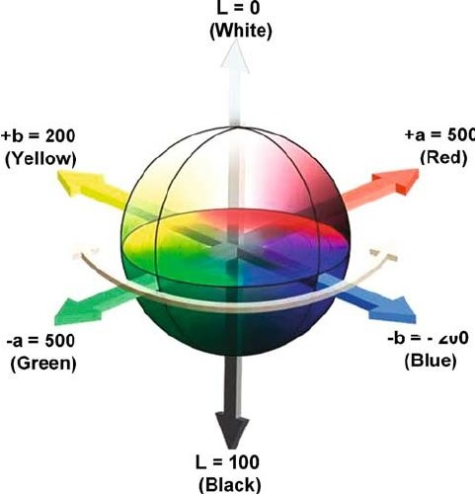
Problems (Most Occurring)
a* not in (-0,2;0,2) green – red range
Notes:
A* is the green-red color spectrum of the sand. The sand cannot be to green nor to red and has to lay in specific bounds.

Slide 16
Causes
Input Quality
Setpoints
Notes:
Next we isolated which variables can cause color problems.
Setpoints are the knobs of the production process that engineers can turn in order to influence the quality of the output product.

Slide 17
How to optimize quality?
Input Variables
Color Quality
Good
Bad
Input layer
Output layer
Hidden layers
PREDICT
Notes:
Now how do we optimize quality, well first, we want to learn how these input variables influence the color. If we can create a machine learning model that can accurately predict color quality,

Slide 18
How to optimize quality?
Input Variables
Color Quality
Good
Bad
Input layer
Output layer
Hidden layers
EXPLAIN
Notes:
then we can extract how the input variables should be set for good color quality with explainable AI

Slide 19
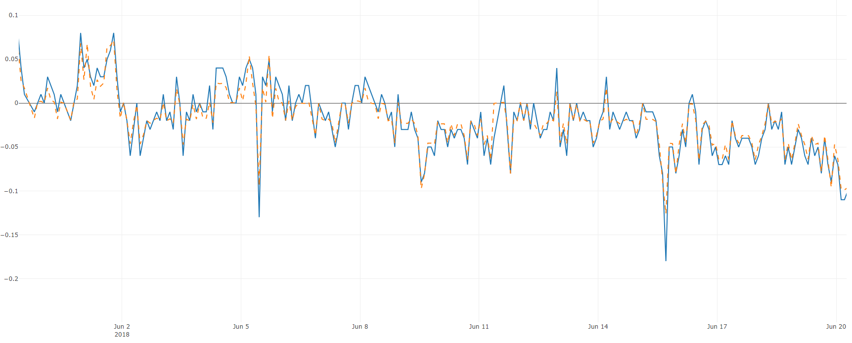
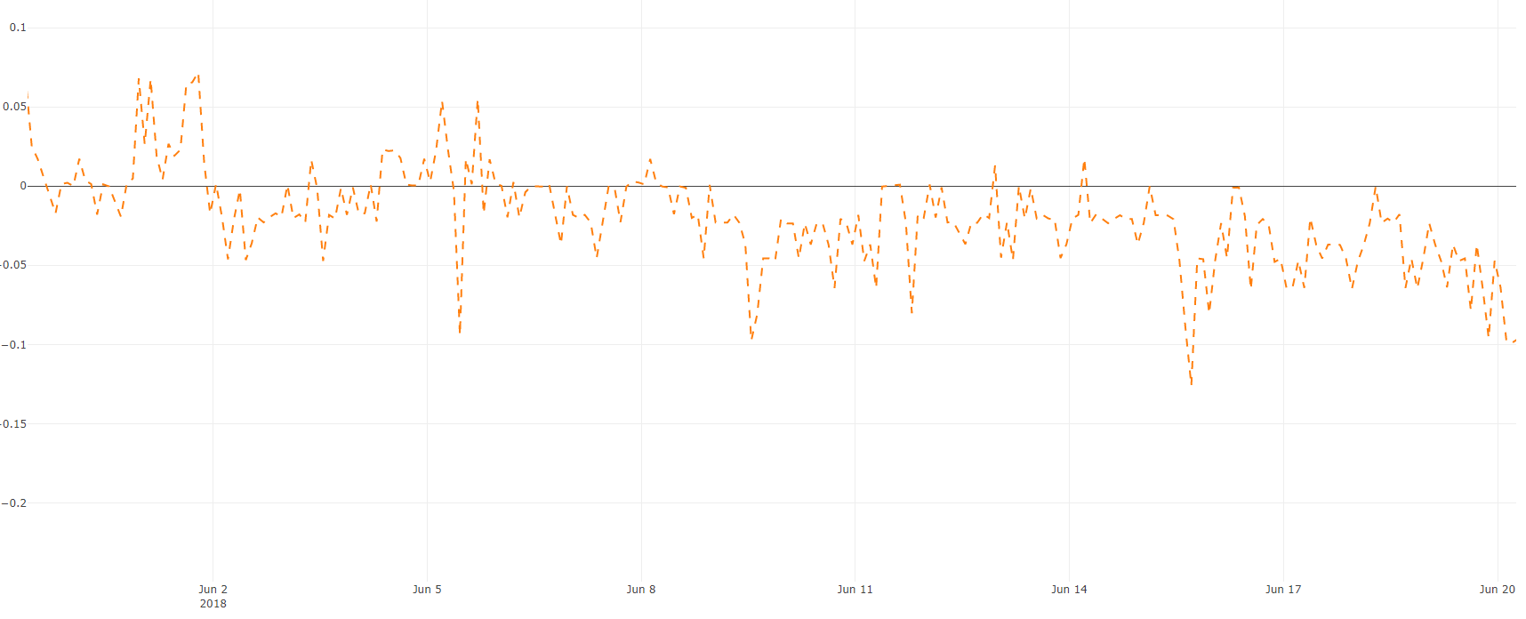
Prediction
Predict quality of color 2 hours in advance

Slide 20
Explanation
How should setpoints be adjusted to improve quality?
REDUN_011 | 170
REDUN_012 | 0
REDUN_013 | 33
REDUN_014 | 0
REDUN_015 | 289
REDUN_016 | 90
REDUN_017 | 0
REDUN_018 | 82
REDUN_018 | 123

Slide 21
How to predict maintenance?
Objective
Predict value of temperature sensor in kiln 4 hours in advance to anticipate failure of production process
9% too low
1% too high

Slide 22
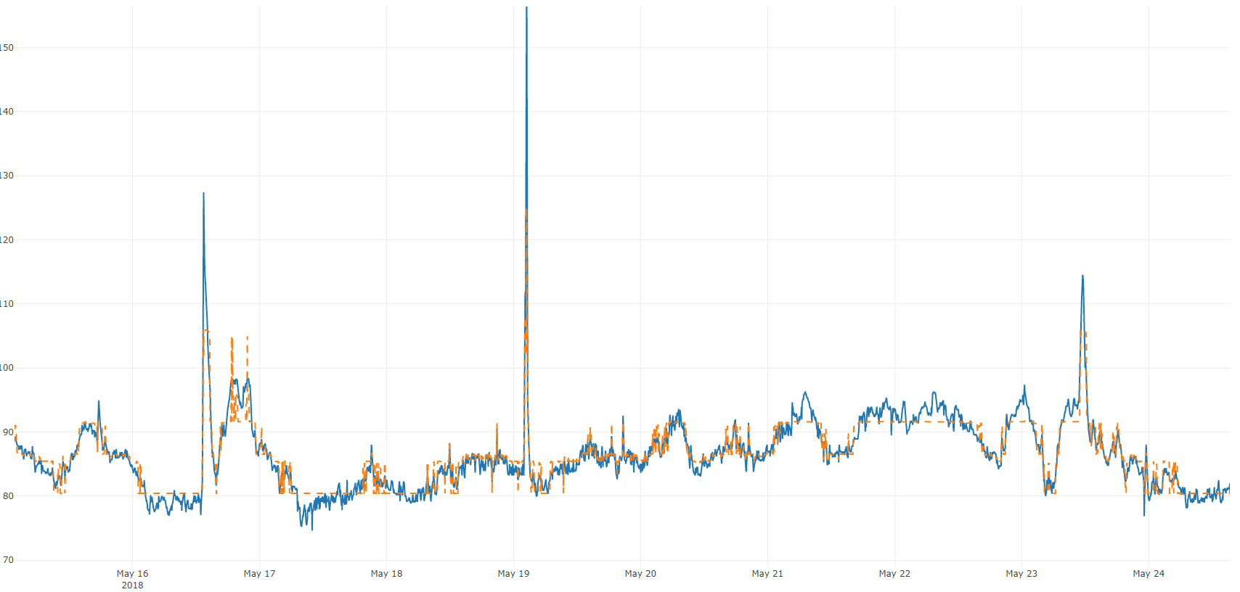
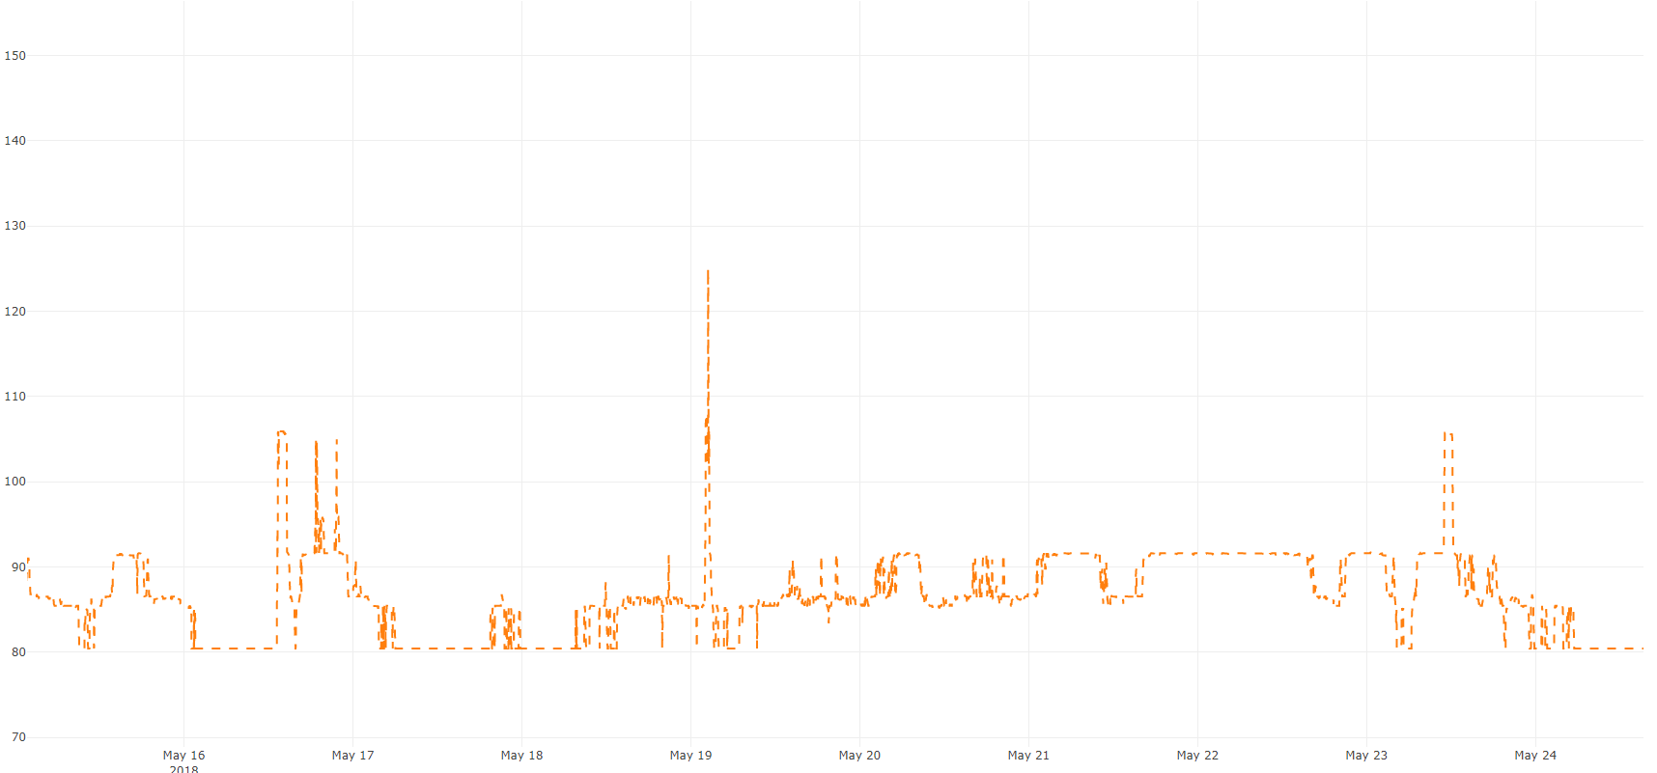
Prediction
Predict value of sensor 4 hours in advance
Notes:
Hoe verschilt dit met de oplossing van vandaag?
- monitoring

Slide 23
Recap
New kiln has been made more performant, reducing
Maintenance costs
Quality costs
→ Frees time for engineers, making them more efficient
Notes:
Probleem en oplossing herhalen; wat bidet dat aan mogelijkhenden?→ engineers hebben meer tijd

Slide 24
Azure Integration

Slide 25
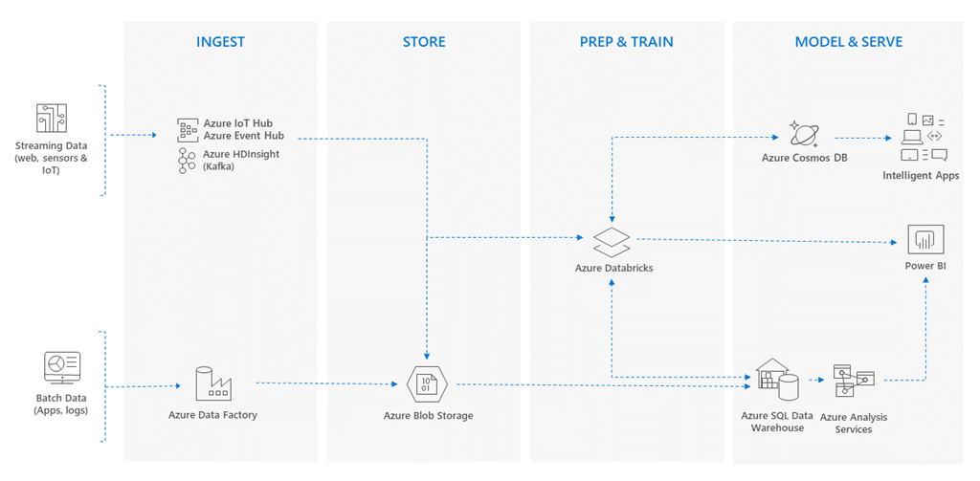
BI Landscape
AI/ Analytics Layer
Notes:
Databricks introduceren als azure service voor datascientist die binnen Microsoft azure architecture past (Cegeka heft het volledige bi platform van de klant opgezet als PAAS en daarbinnen Databrocks geactiveerd)

Slide 26
Analytics Platform
Pay-as-you-go
Fully managed Spark clusters
Azure Active Directory integration
Role-based access controls
Rich programming language support
Collaboration platform

Slide 27
breght.vanbaelen@cegeka.com
linkedin.com/company/cegeka
Universiteitslaan 9
3500 Hasselt, België
@cegeka
info@cegeka.be

