Slide 1
Integration of Customer Data in a Fleet Scheduling Optimization Problem: From Predictive to Prescriptive Analytics
Ghent University – Department of MIO/Data Analytics
Dirk Van den Poel
Copyright © 2020 Prof. Dr. Dirk Van den Poel, Ghent University: dirk.vandenpoel@UGent.be

Slide 2
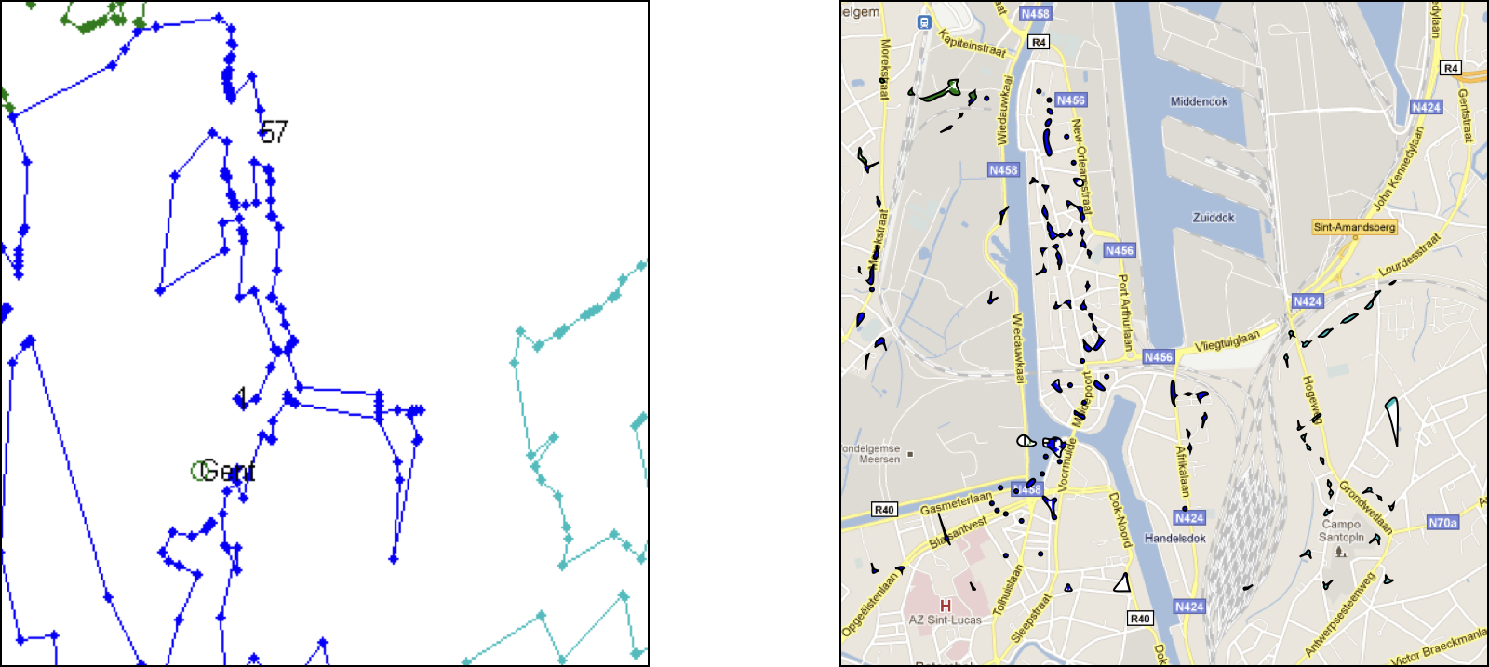
Context
Door-to-door sales + websales

Slide 3
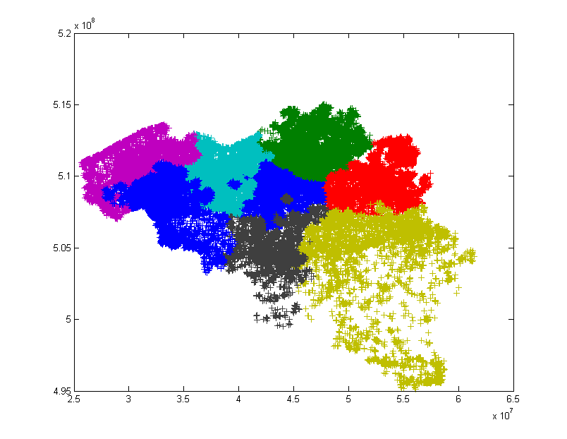
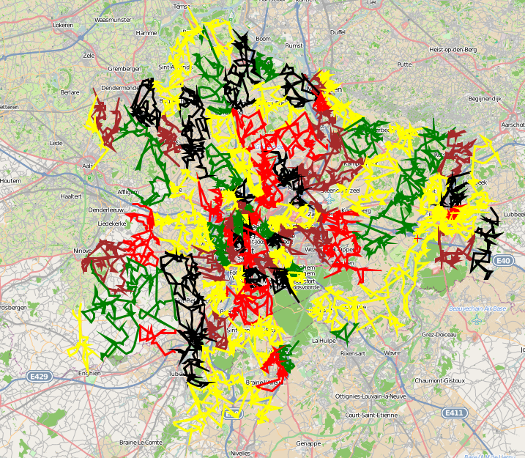
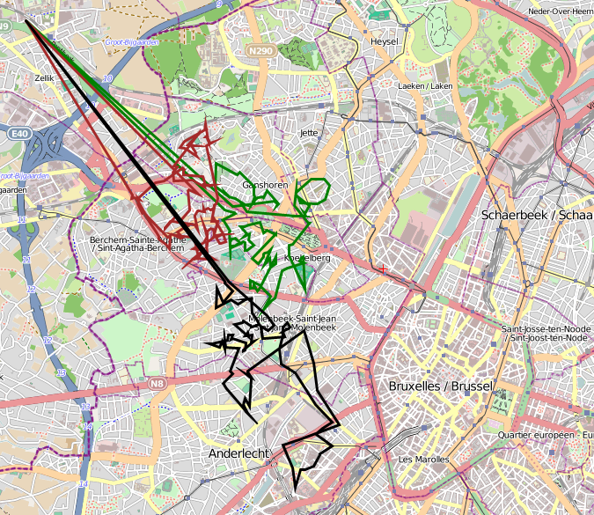
Route
Warehouse
Belgium
Region’s Routes
Detailed
Route
VERCAMER D., VAN DEN POEL D., GENDREAU M. (2020), A Framework for Solving Real-Life Large-Scale Multi-Depot VRP, ready for submission.
VERCAMER D., VAN DEN POEL D., GENDREAU M. & BAECKE P. (2020), Data-Driven Door-to-Door Sales, ready for submission.
Notes:
Stochastic demand

Slide 4
Why?
Challenges
Routing a sales force is a grand challenge
The scale of the operation: 120 000+ customers
Many complicating factors: professional deliveries before a certain time of the day, …
Combining the marketing challenge with the logistics (routing) challenge
Copyright © 2020 Prof. Dr. Dirk Van den Poel, Ghent University: dirk.vandenpoel@UGent.be

Slide 5
Case: Door-to-Door Sales
Customer Analytics & Logistics Management
CRM
Transactional data
Customer profiles
Enhanced Analytics
Analytics interface
Logistics interface
Enhanced Fleet Dispatching
Route templates
Standard Analytics
Website
Clickstream data
Standard Fleet Dispatching
Ensure that Customer Analytics is the source of a
Smart Logistics Management & improve over time.
Copyright © 2020 Prof. Dr. Dirk Van den Poel, Ghent University: dirk.vandenpoel@UGent.be

Slide 6
What & How?
How did we realize this product/service?
AI/Machine Learning in 2 parts: customer targeting & logistics part
Algorithms implemented in C++ for speed + parallel execution
UI implementation by IT partner
GUI in C#

Slide 7
Copyright 2020. Prof. Dr. Dirk Van den Poel, Ghent University: dirk.vandenpoel@UGent.be

Slide 8
Lessons learned
What suggestions do you have for other companies who want to implement AI/ML?
Change management: Introducing a new way of working is a challenge
Role of Unions
What were the hardest problems you had to tackle?
Getting the right data in a timely manner (from multiple sources)
Getting the human/machine interface right

