Slide 1
Reinventing Marketing When AI tells you how to reach 10% more sales
Sven Arnauts
sven.arnauts@delaware.ai +32 485 36 14 43

Slide 2
87% of marketers say data is their company’s most under-utilized asset

Slide 3
5% of marketers use customer data to improve their sales & marketing.
Notes:
ONLY 5%!!! → why is this?

Slide 5
CASE STUDY
Funeral insurer & organizer
Indirect sales model through several brokers & other partners
Always-on digital media spent, radio/tv/print campaigns yearly
Media spent data in Excel, sales data from ERP
mission statement
predict the ROI of marcom and define the optimal marketing-mix
Credits: DELA

Slide 6
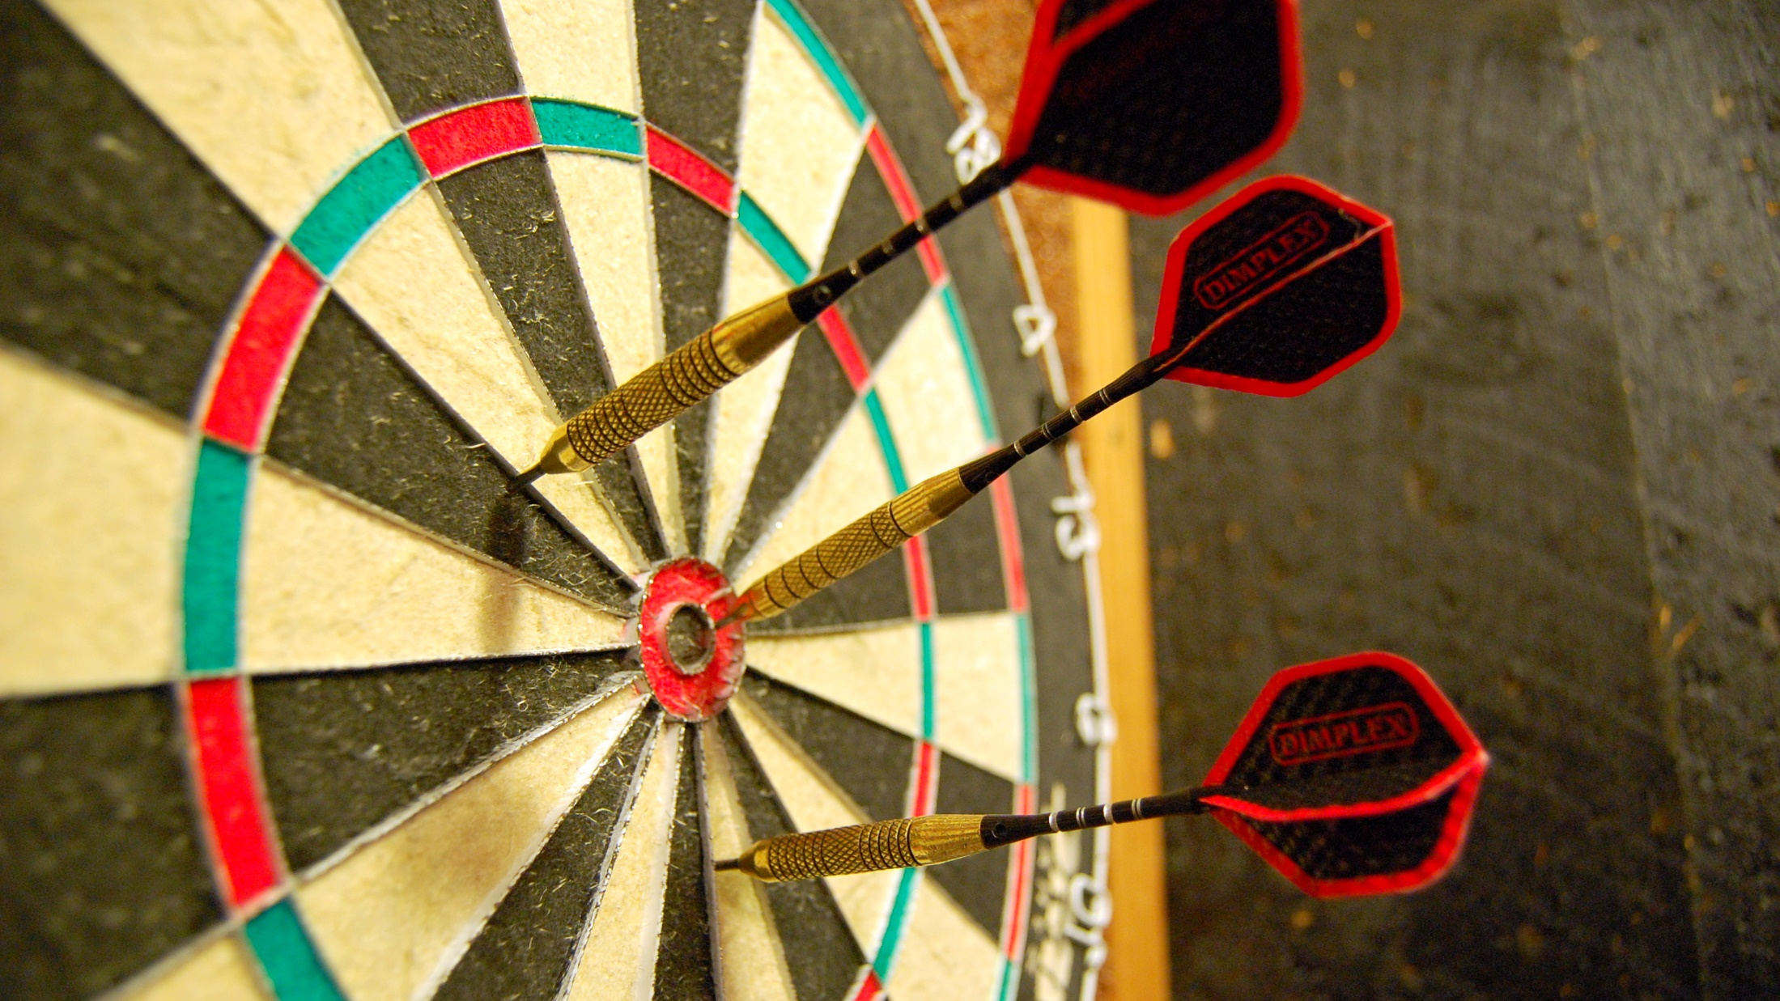
MEDIA PLANNING TODAY
Notes:
Hit and miss
Too much guess work
Not taking external factors into consideration

Slide 7
DELA’s QUESTION
When I do a
Campaign type
with
content
in
Month of year
on
Channel
with
channel specifics
at this price:
This will bring
€ in new valuable, long term business

Slide 8
DELA’s QUESTION
When I do a
Campaign type
with
content
in
Month of year
on
Channel
with
channel specifics
at this price:
This will bring
€ in new valuable, long term business
intelligence

Slide 9
DELA’s Next question
I want to generate
€ in new valuable, long term business,
I will realize it through
Campaign type
with
content
in
Month of year
on
Channel
with
channel specifics
at this price:

Slide 10
DELA’s Next question
I want to generate
€ in new valuable, long term business,
I will realize it through
Campaign type
with
content
in
Month of year
on
Channel
with
channel specifics
at this price:
intelligence

Slide 11
800+ VARIABLES
Timing
Duration
Time since last campaign
Mix
Total budget
Hours of daylight
Interaction terms
Quadratics
Lags
Cumulatives
…
Notes:
Alles wat een impact heeft op aantal nieuwe polissen
Combinaties van alle invulvelden
Cumulatieven kwadraten, interaction termen op alles

Slide 12
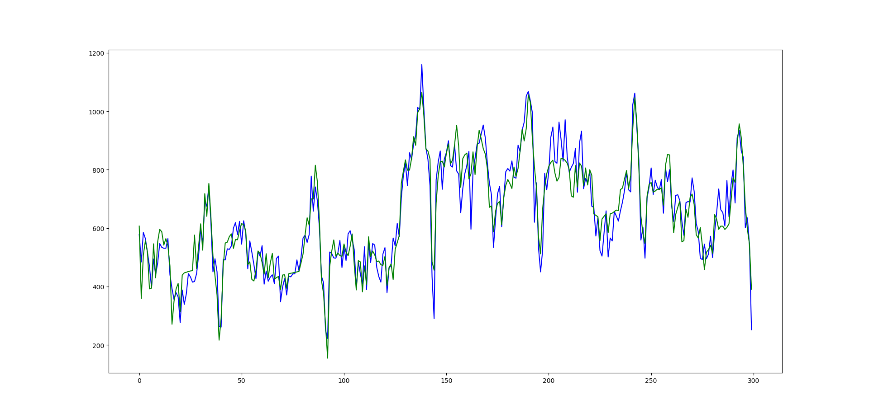
Model PERFORMANCE
MODEL ACCURACY
2013
2019
Blue: sales data– Green: model prediction
Notes:
Stress historical data – copy/paste of reality
→ Prediction accuracy 82%
→ +26% salescontracts mention here as well

Slide 13
3 things
we learned
Notes:
Question: zijn er mensen die hier al mee bezig zijn? En wat hebben jullie daaruit geleerd?

Slide 14
Channel | Type | Spent | Impressions | Start date | End date
Paid social | Facebook ad | € 373,49 | 13.027 | 09/10/2015 | 16/10/2015
Paid social | Instagram ad | € 120,00 | 2.302 | 09/10/2015 | 11/10/2015
Display | Media display ads | € 50.000 | 380.000 | 09/10/2015 | 10/11/2015
…
DO: KEEP TRACK OF YOUR DIGITAL MARKETING SPENT
Notes:
Historical data may be daunting
So start keeping track now

Slide 15
MARKETERS need to require a NEW MINDSET
Notes:
THIS IS AN OPERATIONAL MODEL

Slide 16
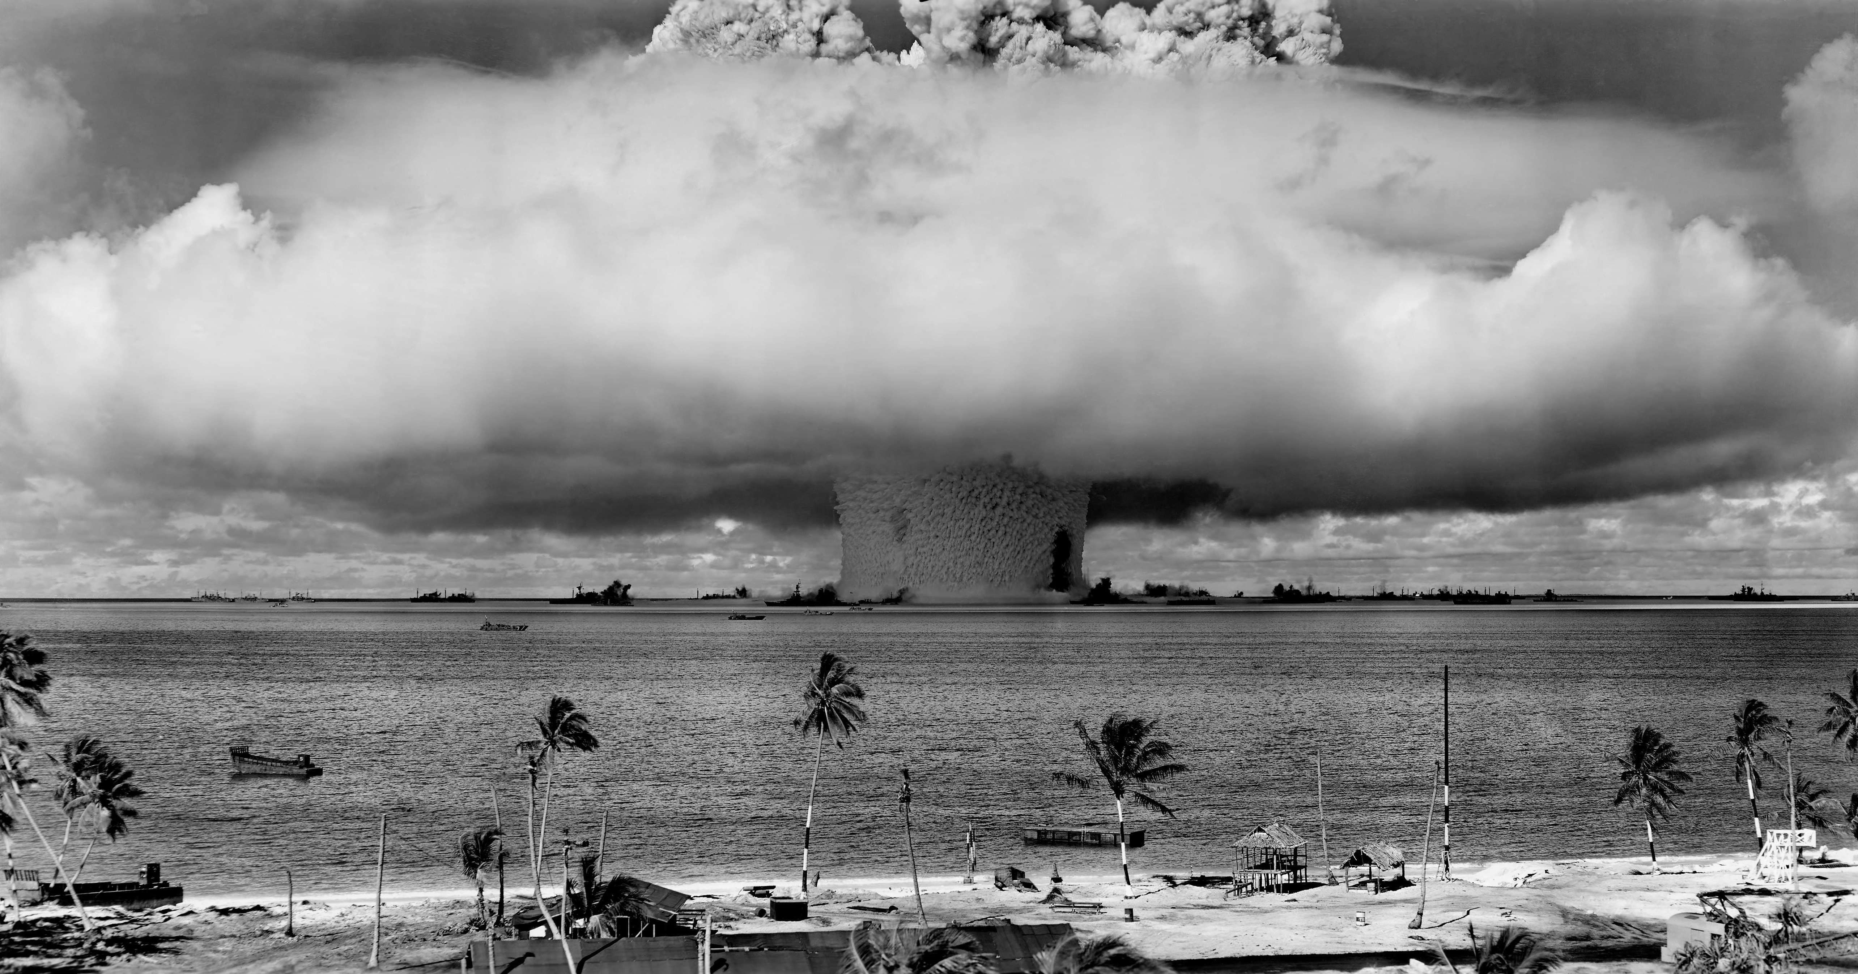
computer says “YES”
Notes:
IT’s MAN TOGETHER WITH MACHINE

Slide 17
you
think

