Slide 3
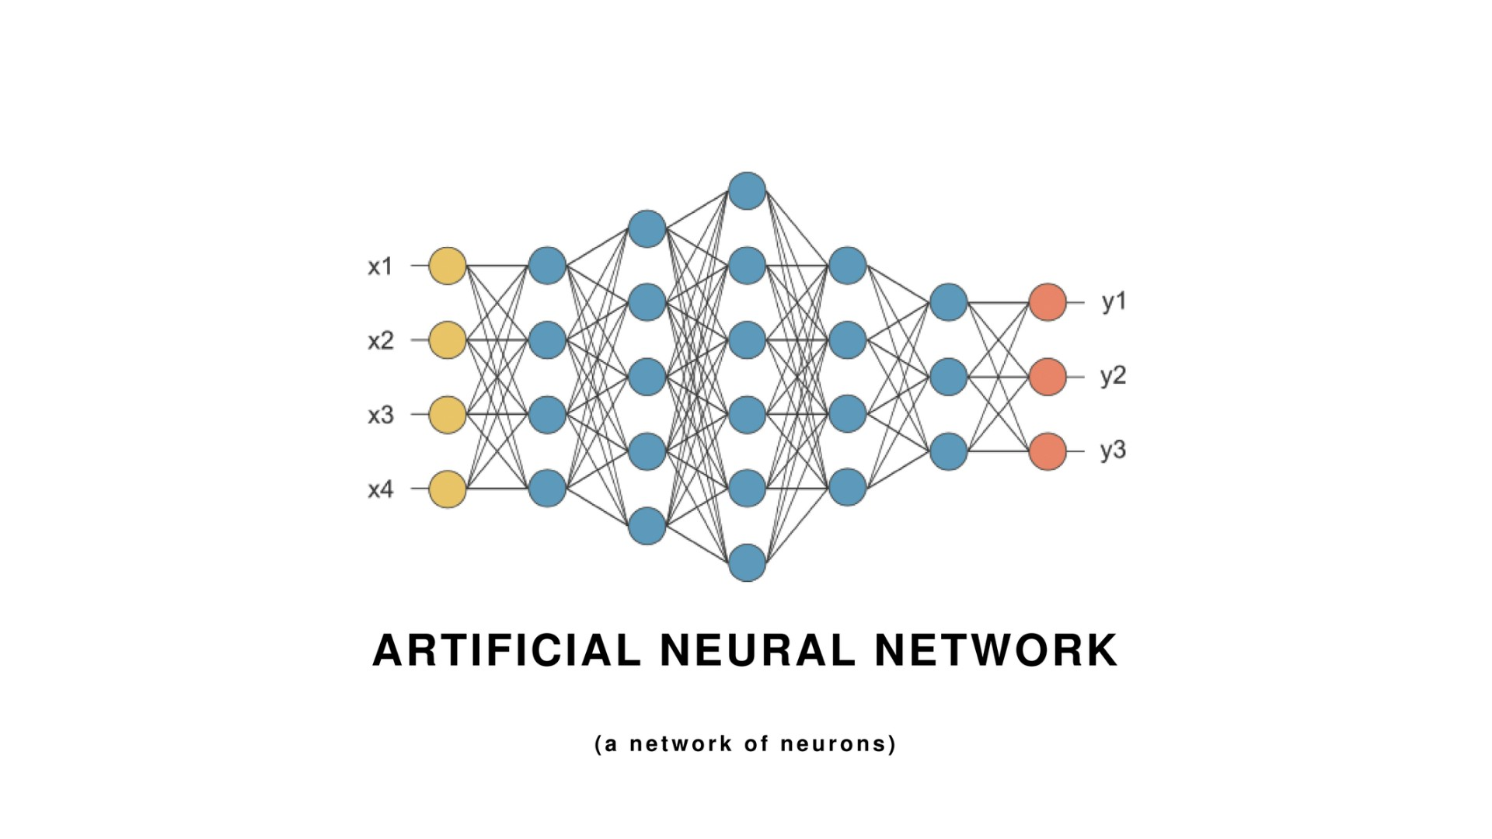

Slide 4
Natural Language: Sequence based data

Slide 6
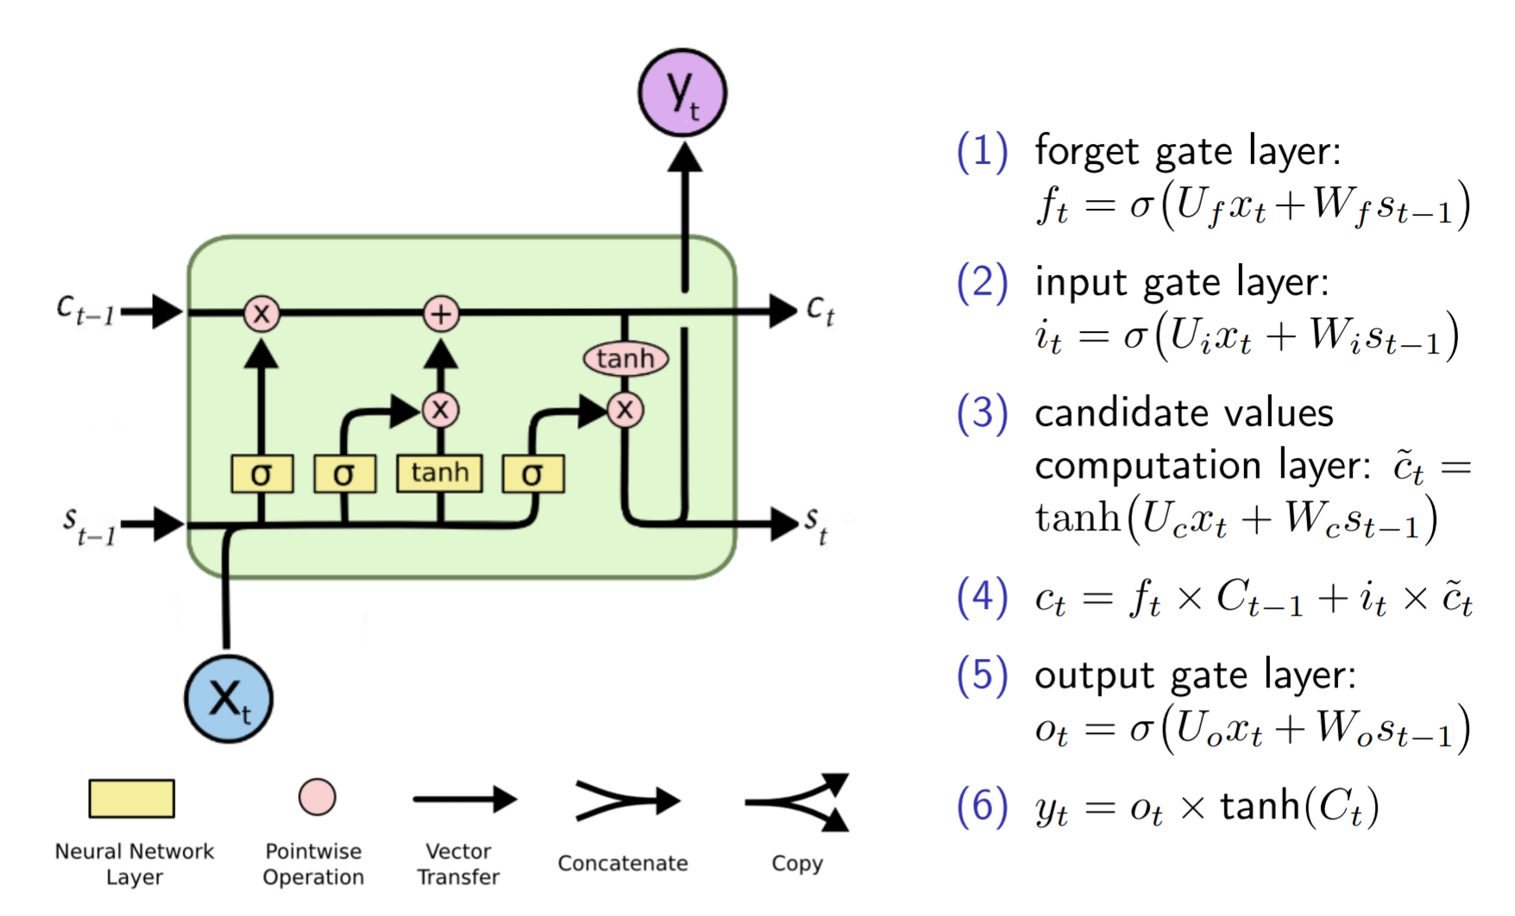
Long Short Term Memory networks

Slide 7
Sequential operations

Slide 8
Convolutional Neural Networks

Slide 9
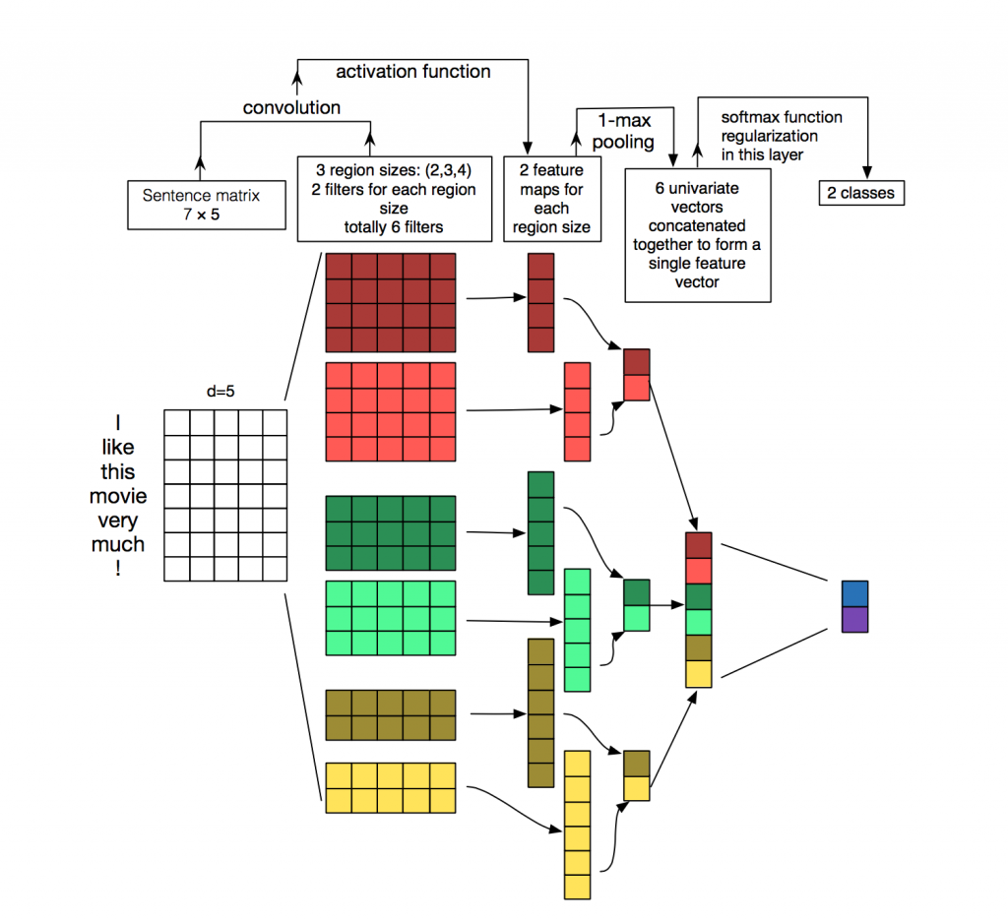
Convolutional Neural Networks NLP style

Slide 10
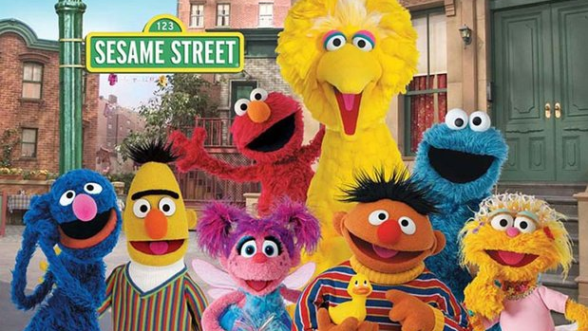
BERT AND THE OTHER TRANSFORMERS

Slide 25
THANK YOU FOR YOUR ATTENTION!
QUESTIONS?
CONTACT US
STAY IN TOUCH
info@brainjar.ai
+32 (0) 473 36 15 55
Gaston Geenslaan 11, B4
3001 Leuven
https://brainjar.ai
https://twitter.com/brainjarai
https://nl.linkedin.com/company/brainjarbe

