Slide 1
SKILLS 3.0
AI & Adaptive Learning
for emerging skills
Notes:
Agenda overlopen
Intro & crash course in NLP
Why & how Europe is investing in education research
The project & demo’s
Q&A session
Also short question session after every demo

Slide 2
ABOUT TECHWOLF
ML Start-up from Belgium
AI for employee lifecycle management
Competency based approach

Slide 3
ABOUT EIT KIC INNOENERGY
European Institute of Innovation & Technology
Powered by major energy players
$500M+ invested in renewables
Notes:
The Innovation Communities carry out activities that cover the entire innovation chain:
(1) training and education programmes,
(2) reinforcing the journey from research to the market,
(3) innovation projects,
(4) business incubators and accelerators.
The EIT’s role is to guide the process and set the strategies => KICS implementation.

Slide 4
OF WORKERS ARE
IN NEED OF RESKILLING
-Source: World Economic Forum
Notes:
What triggered you to think about using AI/ML? What was your need?
Leverage market data to discover trending skills
Understand what a person’s skills are
Understand requirements & skills acquired
Which problems/challenges enforced you to implement AI/ML in the solution?
Analyzing ±250M Vacancies

Slide 5
SKILLS 3.0
AI to improve decision making in education
Predict future skills & skill shortages
Global and individual level

Slide 6
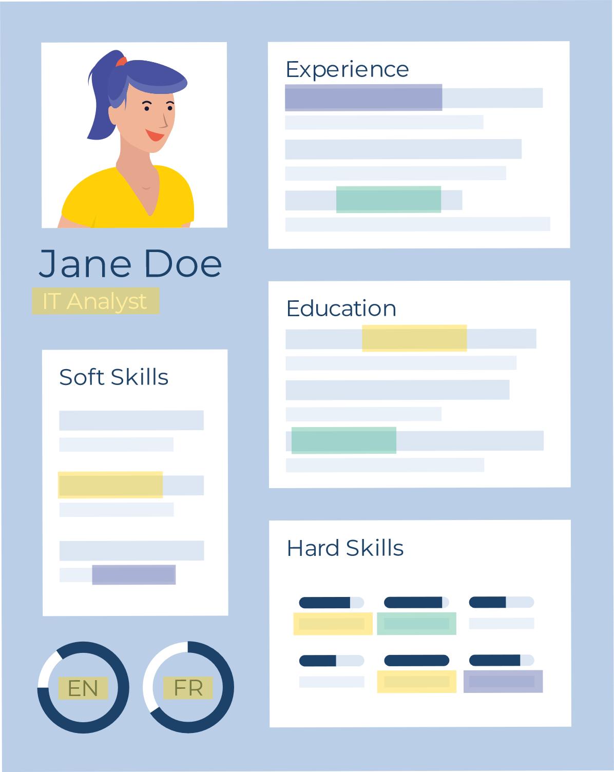
ASSESSING SKILL GAPS
WORKER
RESUME
JOB
OPPORTUNITY
?
Notes:
We already know how to extract skills from a vacancy

Slide 8
SCALING
250M Vacancies
Notes:
250M Vacancies = 20x bigger than English Wikipedia (often used in NLP)
A true big data approach

Slide 9
FINDING THE RIGHT COURSE
SKILL
GAP
Notes:
Related to matching a person to a vacancy
For our skill engine, matching a skill profile to a skill profile is the same. Irrespective to the source

Slide 10
DEMO
Smart course recommendations

Slide 11
FUTURE PLANS
...
Notes:
Volledig curriculum samenstellen
Project uitgebreid naar 2022 cross-KIC

Slide 12
Q&A
Ask away!

