Slide 1
Using AI to develop skills at the pace of disruption
We want teams to do better
hello@uman.ai - www.uman.ai
Trusted by

Slide 2
Hi,
I’m Charles
Engineering Physics @Ghent University
Machine Learning Engineer @ML6
3 years of experience in AI in HR
Founder and technical lead @uman.ai
charles@uman.ai
www.uman.ai
+32 4 98 12 99 14

Slide 3
Our journey
AI-enabled Collaboration
Increase team productivity
Close your digital skills gap
Increase your employee engagement
AI-enabled Knowledge sharing
AI-enabled Talent Mobility
AI enabled, Peer to peer knowledge sharing platform for engineers
AI-enabled
Recruitment
Matching trainees with their next best position based on continuous feedback data
Automatic matching of candidates and vacancies
based on deep learning models

Slide 4
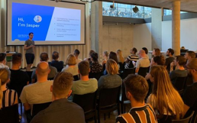
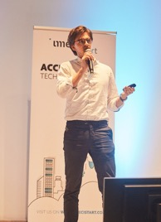
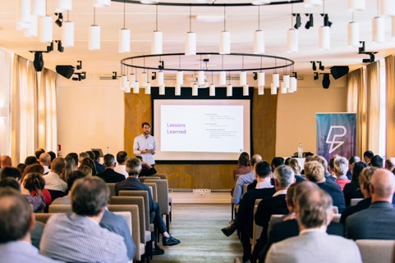
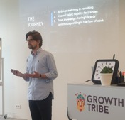
Actively sharing our knowledge along the way
“knowledge is wasted unshared”
“The impact of AI on product development” - UX Beers
checkout presentation
“Upskilling in the future of work” - ICTech day 2019
checkout presentation
“The journey towards an AI enabled workforce” - Growth tribe amsterdam checkout presentation
“The impact of AI on effective collaboration” - imec
checkout presentation

Slide 5
Breaking Lifetime of skills is decreasing faster than ever

Slide 6
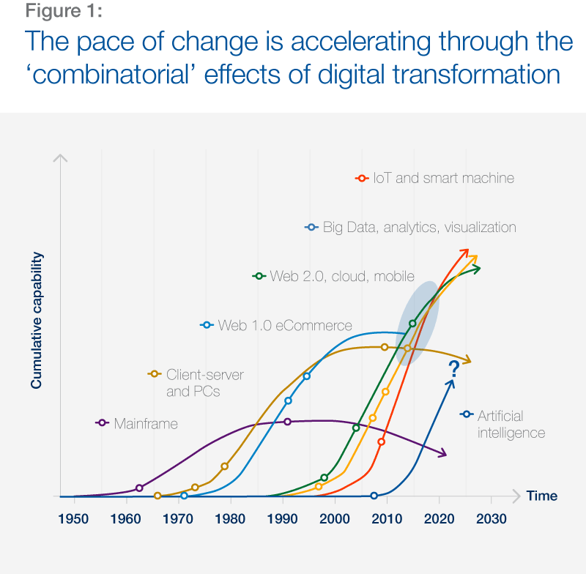
The pace of technological change is becoming exponential
We’re beginning to see the first signs of this happening…

Slide 7
47% of tasks can already be automated with current technology
Source McKinsey
Across all industries

Slide 8
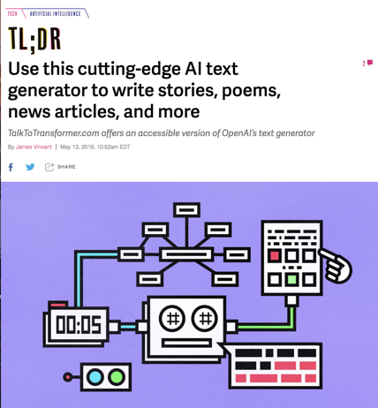
47% of tasks can already be automated with current technology
Source McKinsey
Across all industries AI generates text automatically - OpenAI GPT2

Slide 9
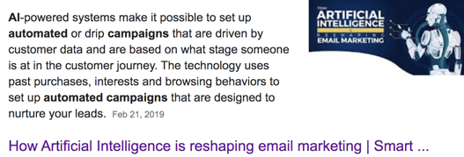
47% of tasks can already be automated with current technology
Source McKinsey
Across all industries AI automates marketing campaign

Slide 10
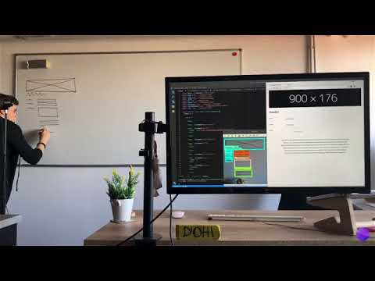
47% of tasks can already be automated with current technology
Source McKinsey
Across all industries From design to functional code

Slide 11
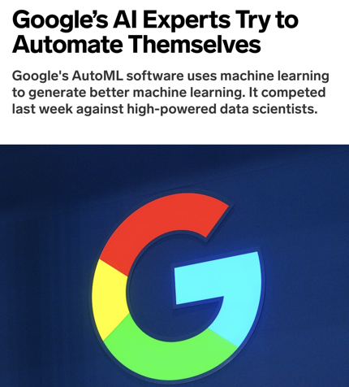
47% of tasks can already be automated with current technology
Source McKinsey
Across all industries AI trains itself - AutoML
Apr 16, 2019

Slide 12
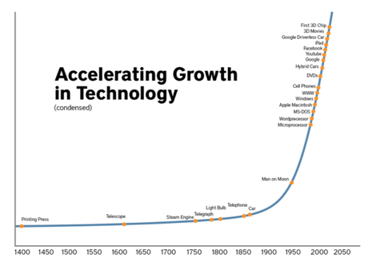
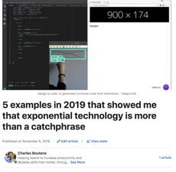
Can we keep up with the velocity of change
Previous examples all happened in 2019
Read the full article here

Slide 13
The impact on your competitive edge
Notes:
Link to strategic workforce planning

Slide 14
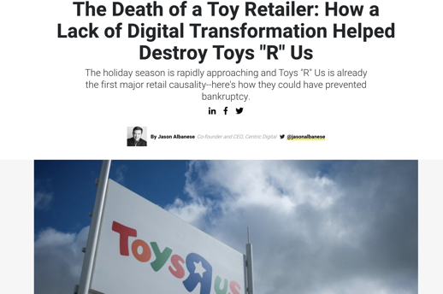
Customers want your service faster, more convenient & cheaper
If you can’t deliver, you lose everything

Slide 15
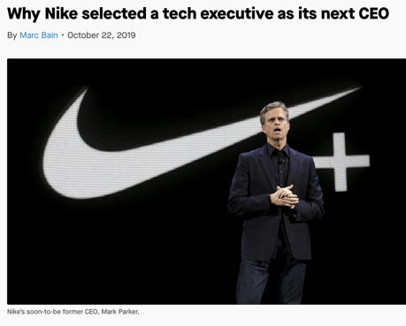
Customers want your service faster, more convenient & cheaper
Nike asked themselves
“Are we a shoe company that uses tech, or a tech company that sells shoes?”

Slide 16
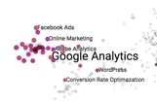
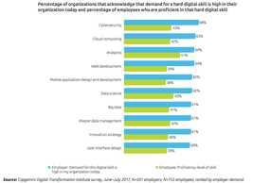
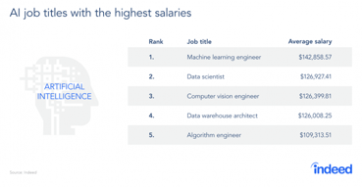
You need digital skills, but they are scarce and expensive
Expensive to recruit
Hard to find

Slide 17
Can you develop employee skills at the pace of disruption?
Source

Slide 18
Can you develop employee skills at the pace of disruption?
Source
Rise of a new technology or trend
Skill 1 becomes commodity
Market demand
Skill lifetime
Legacy support
Skill A
time

Slide 19
Can you develop employee skills at the pace of disruption?
Source
Half-life of a skill is approx. 5 years and decreasing faster than ever
Skill A
Skill B
Skill C
Market demand
Skill lifetime
Skill lifetime
Skill lifetime
Today we are at 5 years
time

Slide 20
You can turn this market volatility into an opportunity
Skill lifetime becomes increasingly shorter
<5 years atm.
Market volatility

Slide 21
You can turn this market volatility into an opportunity
Skill lifetime becomes increasingly shorter
<5 years atm.
Speed of activating your workforce towards high demand skill areas
Market volatility + speed

Slide 22
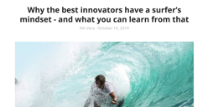
You can turn this market volatility into an opportunity
Skill lifetime becomes increasingly shorter
<5 years atm.
Speed of activating your workforce towards high demand skill areas
Market volatility + speed = Huge potential
Read the article here
“Digital came in waves and those that spotted the waves, worked hard to get on top and surfed the wave. They are referred to as disruptors.”

Slide 23
Winning companies ride these waves to optimize generated value
Skill 2
Market demand
Skill 1
Skill 3
time

Slide 24
Winning companies ride these waves to optimize generated value
Skill 2
Spot the trends and upskill your workforce to ride these waves of innovation
Market demand
Skill 1
Skill 3
time

Slide 25
You don’t have to be first to spot the trends...
Notes:
Link to strategic workforce planning

Slide 26
You have to acquire the right skills faster than your competition
You don’t have to be first to spot the trends...
Notes:
Link to strategic workforce planning

Slide 27
Why is this so hard today

Slide 28
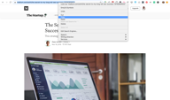
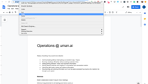
Sharing of information is inefficient, scattered and temporary
Copy pasting urls
Inefficient

Slide 29
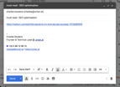
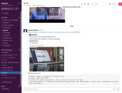
Sharing of information is inefficient, scattered and temporary
Sending emails to yourself
Copy pasting urls
Sharing via chat channels
Inefficient
Scattered

Slide 30
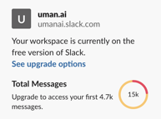
Sharing of information is inefficient, scattered and temporary
Sending emails to yourself
Overloaded messages and emails
Copy pasting urls
9
9
9
Sharing via chat channels
Inefficient
Scattered
Temporary

Slide 31
Scattered information leads to people reinventing the wheel
Admit it, it’s a habit
Turn to Google

Slide 32
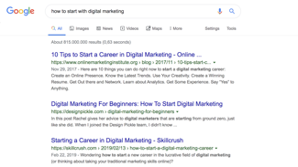
Scattered information leads to people reinventing the wheel
Admit it, it’s a habit
People are using this to solve your customer’s problems
Turn to Google
Scan through results

Slide 33
Scattered information leads to people reinventing the wheel
Admit it, it’s a habit
People are using this to solve your customer’s problems
“Use me!!”
Best practice, hidden somewhere in your knowledge base
Turn to Google
Scan through results
Reinvent the wheel

Slide 34
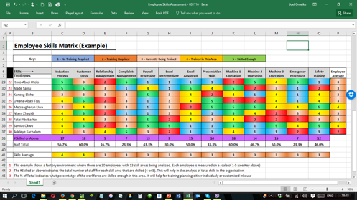
Manual and static skill measuring is hard to make actionable
Manual and finite competency list
Quickly outdated
Lots of work

Slide 35
The Challenge
Can we leverage current technologies to enable teams to increase productivity and develop skills that matter

Slide 36
Deep learning at its core

Slide 37
How a neural network “sees”
Input
Simple feature representations
Combine simple features
Complex features
REPRESENTATION POWER INCREASES

Slide 38
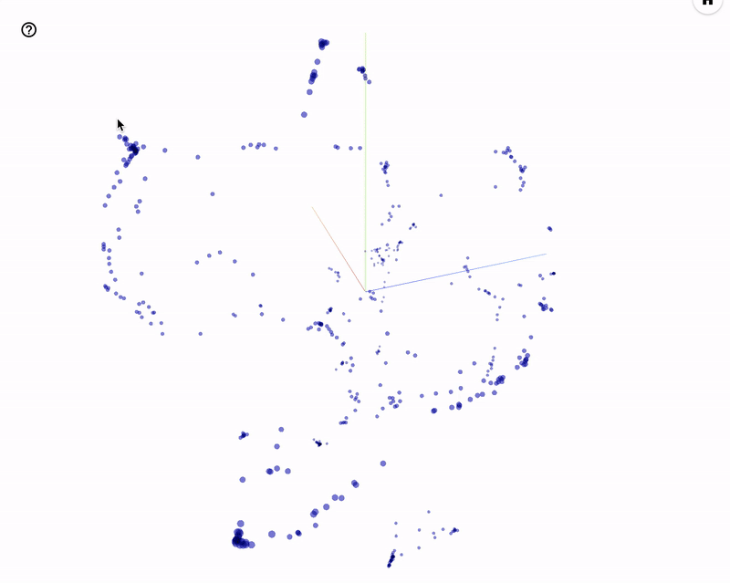
Leverage AI technology
AI powered, organically growing skills engine
Visualize our skills engine

Slide 39
Leveraging Cloud technology
“The future is collaborative,
and collaboration will move to the browser”
The cloud makes everything accessible in the browser
Browser technology is already drastically improving your productivity

Slide 40
With uman.ai,
Teams develop skills
that matter
on auto-pilot
We want teams to do better
hello@uman.ai - www.uman.ai
Trusted by

Slide 41
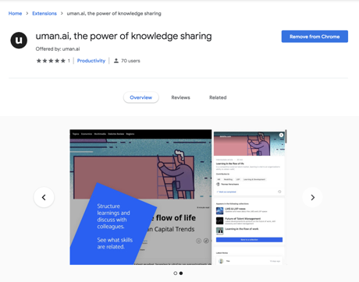
Not another tool, the browser extension works out of the box
Works in your browser of choice
works of the shelf
No integrations required

Slide 42
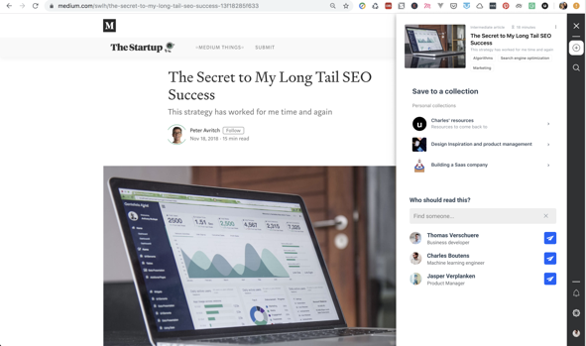
The easiest way to share information & insights
Save with the push of a button

Slide 43
The easiest way to share information & insights
Save with the push of a button
auto-tagged

Slide 44
The easiest way to share information & insights
Save with the push of a button
auto-tagged
Save for later

Slide 45
The easiest way to share information & insights
Save with the push of a button
auto-tagged
Save for later
Share with recommended people based on their interests

Slide 46
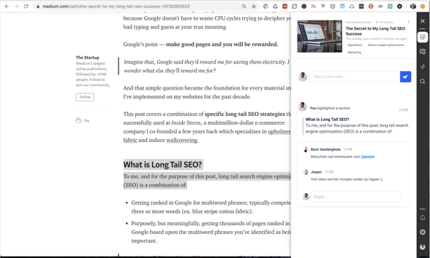
Full contextual collaboration, where and when it matters
Leave a note for your future-self and others
Highlight relevant snippets

Slide 47
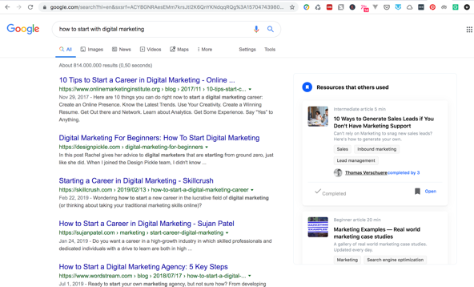
The right piece of knowledge in your flow of work
We don’t change habits
Enrich any search engine with company content
Works in any search engine
...

Slide 48
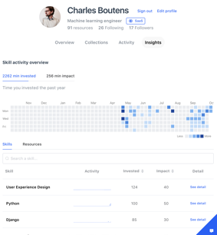
Skill progression is automatically measured in real time
Individual skill progression
Offered as an API to integrate in your current processes

Slide 49
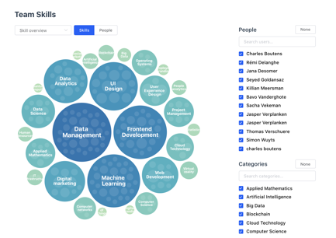
Skill progression is automatically measured in real time
Aggregated over team
Individual skill progression
Aggregated over skill clusters
Offered as an API to integrate in your current processes

Slide 50
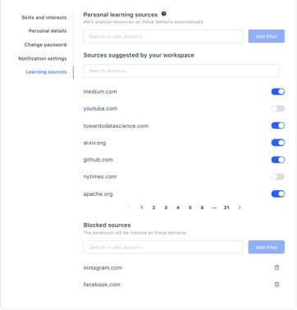
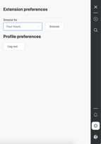
Above and beyond GDPR compliant
We only store metadata when you visit a white-listed domain
Browser extension can be snoozed or disabled, at any time
Fully personalizable whitelist
Whenever works for you

Slide 51
AI powered, organically growing skills engine
Visualize our skills engine
Personalized & contextual recommendations
Automatic skill measuring
Skill & profile matching
Every time a new skill is added our AI skills engine learns this skill and adds it to its skills vocabulary.

Slide 52
Client story
Fast growing
AI consultancy firm

Slide 53
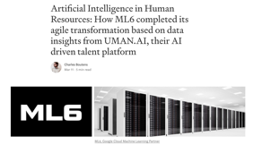
Fast growing AI consultancy firm
ML6 is a fast growing AI consultancy firm — with main offices in Ghent, Amsterdam, Berlin and London. With the rising market demand for machine learning and data processing expertise, the team grew rapidly from 5 people to over 60 in only 2 years time.
Checkout this blogpost on the ML6 case

Slide 54
Fast growing AI consultancy firm
ML6 is a fast growing AI consultancy firm — with main offices in Ghent, Amsterdam, Berlin and London. With the rising market demand for machine learning and data processing expertise, the team grew rapidly from 5 people to over 60 in only 2 years time.
How were they able to grow so fast?
Spot technology trends
Continuously upskilling high potential graduates to these high valuable skills
Checkout this blogpost on the ML6 case

Slide 55
Fast growing AI consultancy firm
ML6 is a fast growing AI consultancy firm — with main offices in Ghent, Amsterdam, Berlin and London. With the rising market demand for machine learning and data processing expertise, the team grew rapidly from 5 people to over 60 in only 2 years time.
How were they able to grow so fast?
Spot technology trends
Continuously upskilling high potential graduates to these high valuable skills
→ great employer brand (continuous instream of great talent)
→ high workforce market value
→ digital innovator brand
Checkout this blogpost on the ML6 case

Slide 56
How they ride the waves of innovation
Old skill focus | Technological advancement | New skill focus | Result
Data visualization (Tableau) | Rising potential and demand for ML | Deep learning, TensorFlow, GCP | Became one of google’s first ML partners

Slide 57
How they ride the waves of innovation
Old skill focus | Technological advancement | New skill focus | Result
Data visualization (Tableau) | Rising potential and demand for ML | Deep learning, TensorFlow, GCP | Became one of google’s first ML partners
Chatbot technology | Google Dialog Flow | Natural language processing | Huge project for leading recruiter

Slide 58
How they ride the waves of innovation
Old skill focus | Technological advancement | New skill focus | Result
Data visualization (Tableau) | Rising potential and demand for ML | Deep learning, TensorFlow, GCP | Became one of google’s first ML partners
Chatbot technology | Google Dialog Flow | Natural language processing | Huge project for leading recruiter
Image classification | Google Vision API | Transfer learning, Object tracking | German sports broadcasting customer
AI model optimization | Auto ML | … | ...
This is the core of your business
Matthias Feys - CTO @ML6 “After reaching the mark of 30 consultants, I was continuously thinking about how to scale this process in order to keep our edge.”

Slide 59
Solution for cost effective upskilling at scale
Solution:
Effective sharing via browser extension in the flow of work
Effective learning, personalized content in the flow of work
Automatic skills mapping, realtime skills data showing progress
Key Results - after 1 month
Matthias Feys - CTO @ML6 “I can see from the data insights who is working on which skills in real-time! We’re starting to notice how our time to develop new skills is drastically reducing.”

Slide 60
Key takeaway
The impact of AI is not dependent on the type of algorithm nor the technology stack.

Slide 61
Key takeaway
The impact of AI is not dependent on the type of algorithm nor the technology stack.
You have to fully understand the business problem you are trying to solve, and see where AI technology can be leveraged.

Slide 62
Thank you
Get in touch
Develop skills that matter, on auto-pilot
Charles Boutens
Founder & Technical lead
charles@uman.ai
www.uman.ai
Get started

