Slide 1
Stijn Bogaerts
CEO / Founder

Slide 2
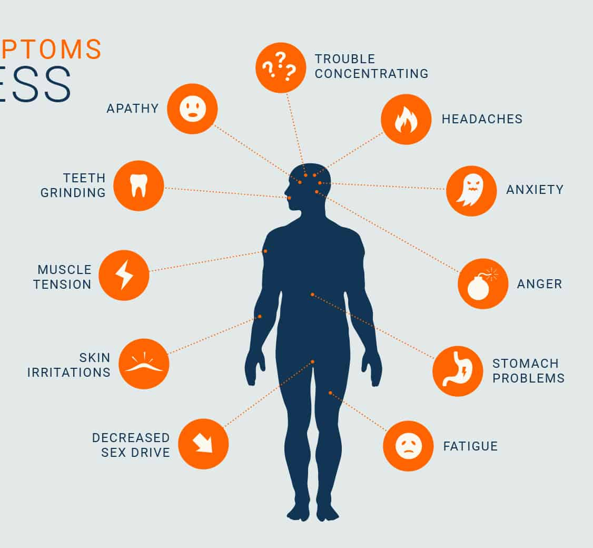
Notes:
WHY:
Challenges
What triggered you to think about using AI/ML? What was your need?
Which problems/challenges enforced you to implement AI/ML in the solution?
What were the advantages of using AI/ML?

Slide 3
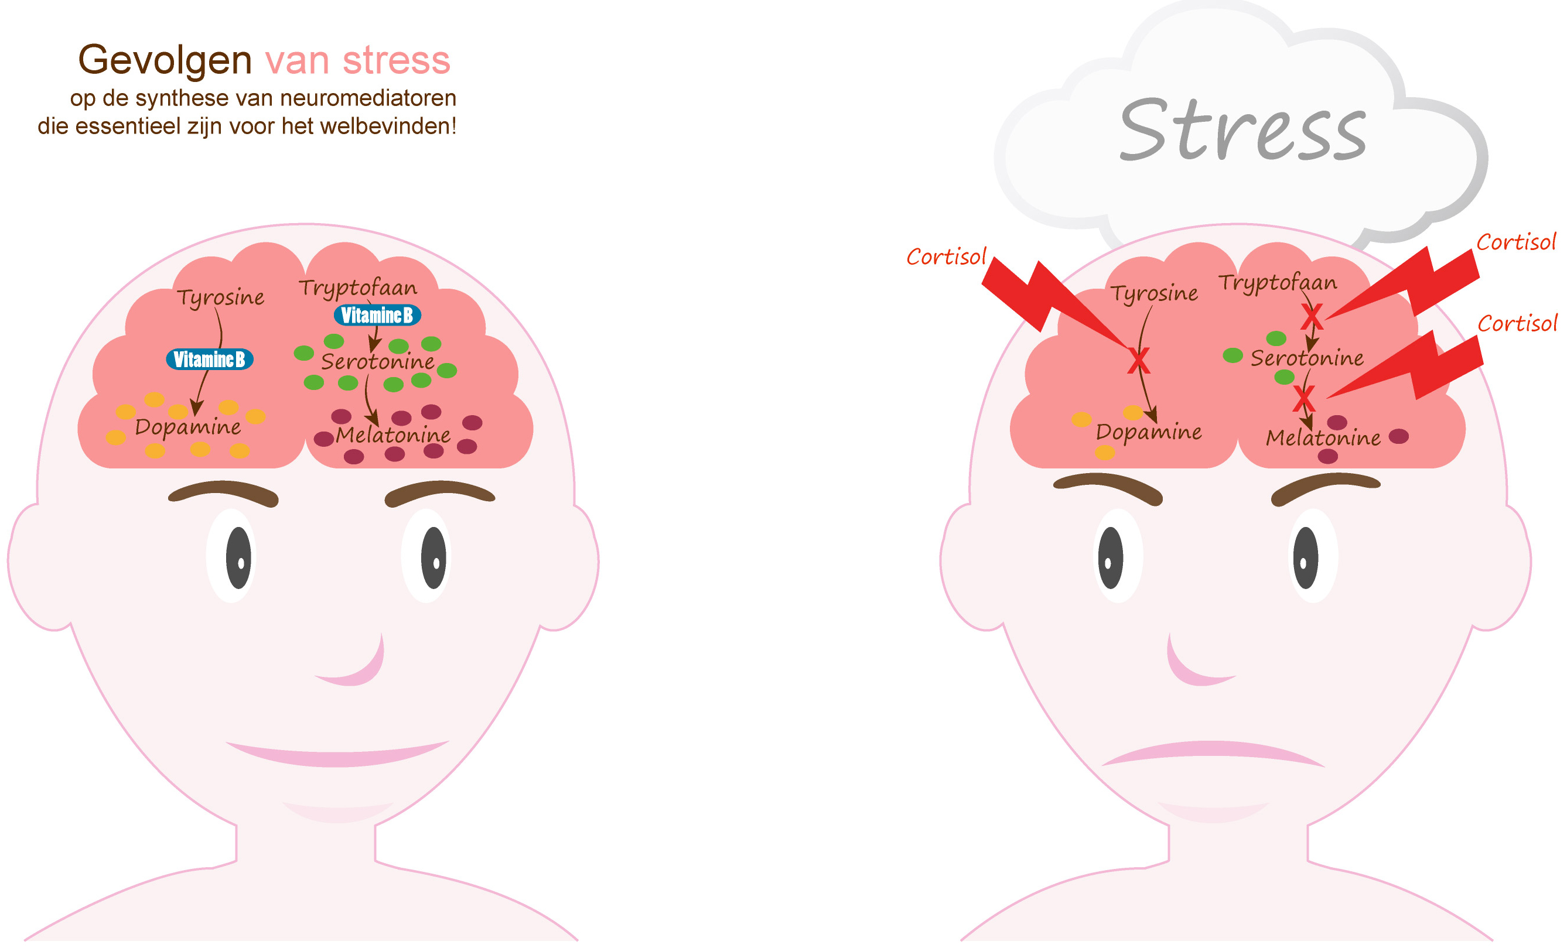
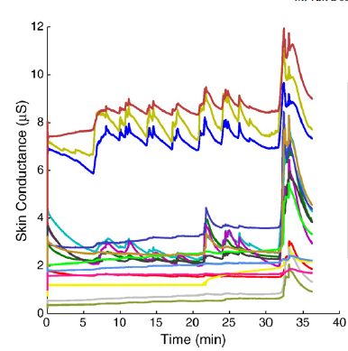
Notes:
WHY:
Challenges
What triggered you to think about using AI/ML? What was your need?
Which problems/challenges enforced you to implement AI/ML in the solution?
What were the advantages of using AI/ML?

Slide 5
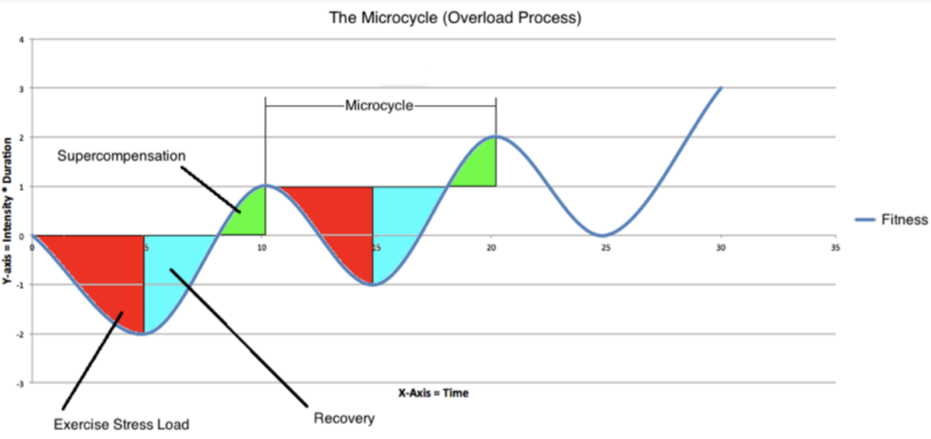
Stress measurement
Well-being
Body
Activity tracker
Motion tracker
Temperature
….
Mind
GSR measurement
Temperature
….
Notes:
What product/service did you realize with AI/ML?
In which way is it innovative?

Slide 6
To optimize your personal well-being!
Monitoring, Connecting, Supporting & Coaching
Movement, Temperature, Stress ….
Notes:
What are the advantages of integrating AI/ML?
Pitch of the product (1 sentence)
…
How did you realize this product/service? Technical background of implementation
What kind of AI (cloud) platform did you use?
Organizational setting (training phase & implementation phase, quality of data, …)
…

Slide 7
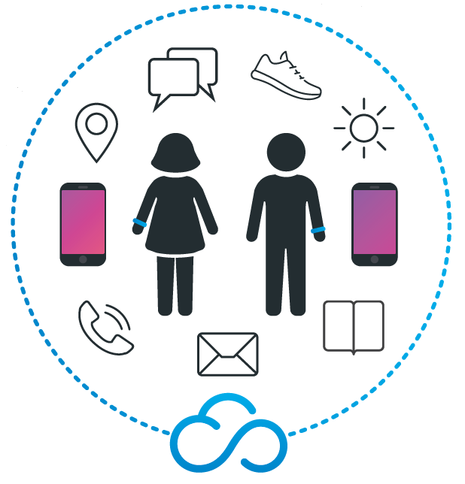
Notes:
How did you realize this product/service? Technical background of implementation
What kind of AI (cloud) platform did you use?
Organizational setting (training phase & implementation phase, quality of data, …)
…

Slide 8
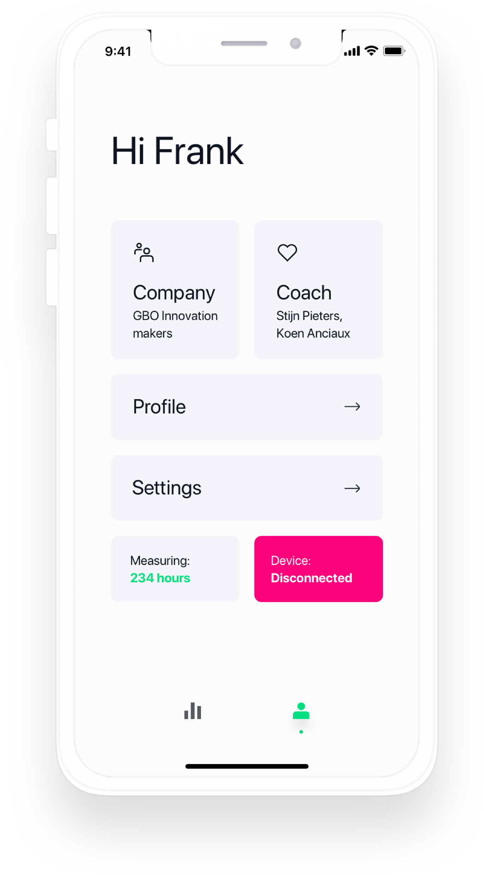
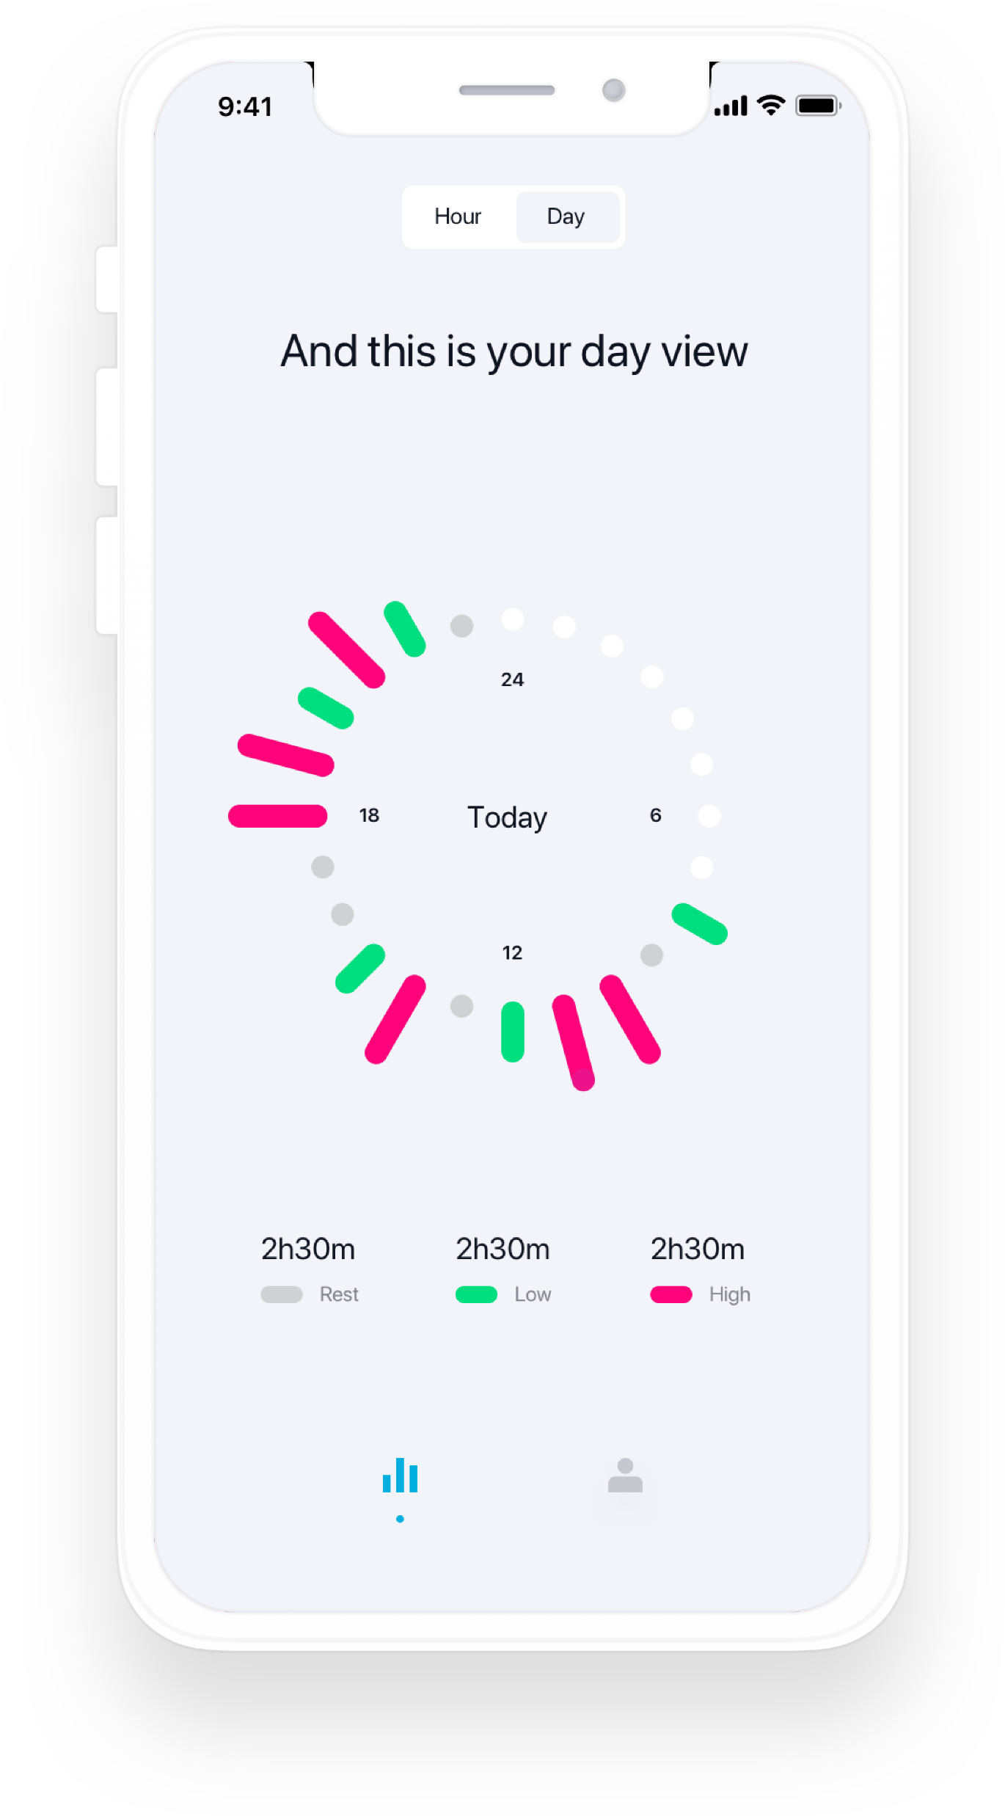
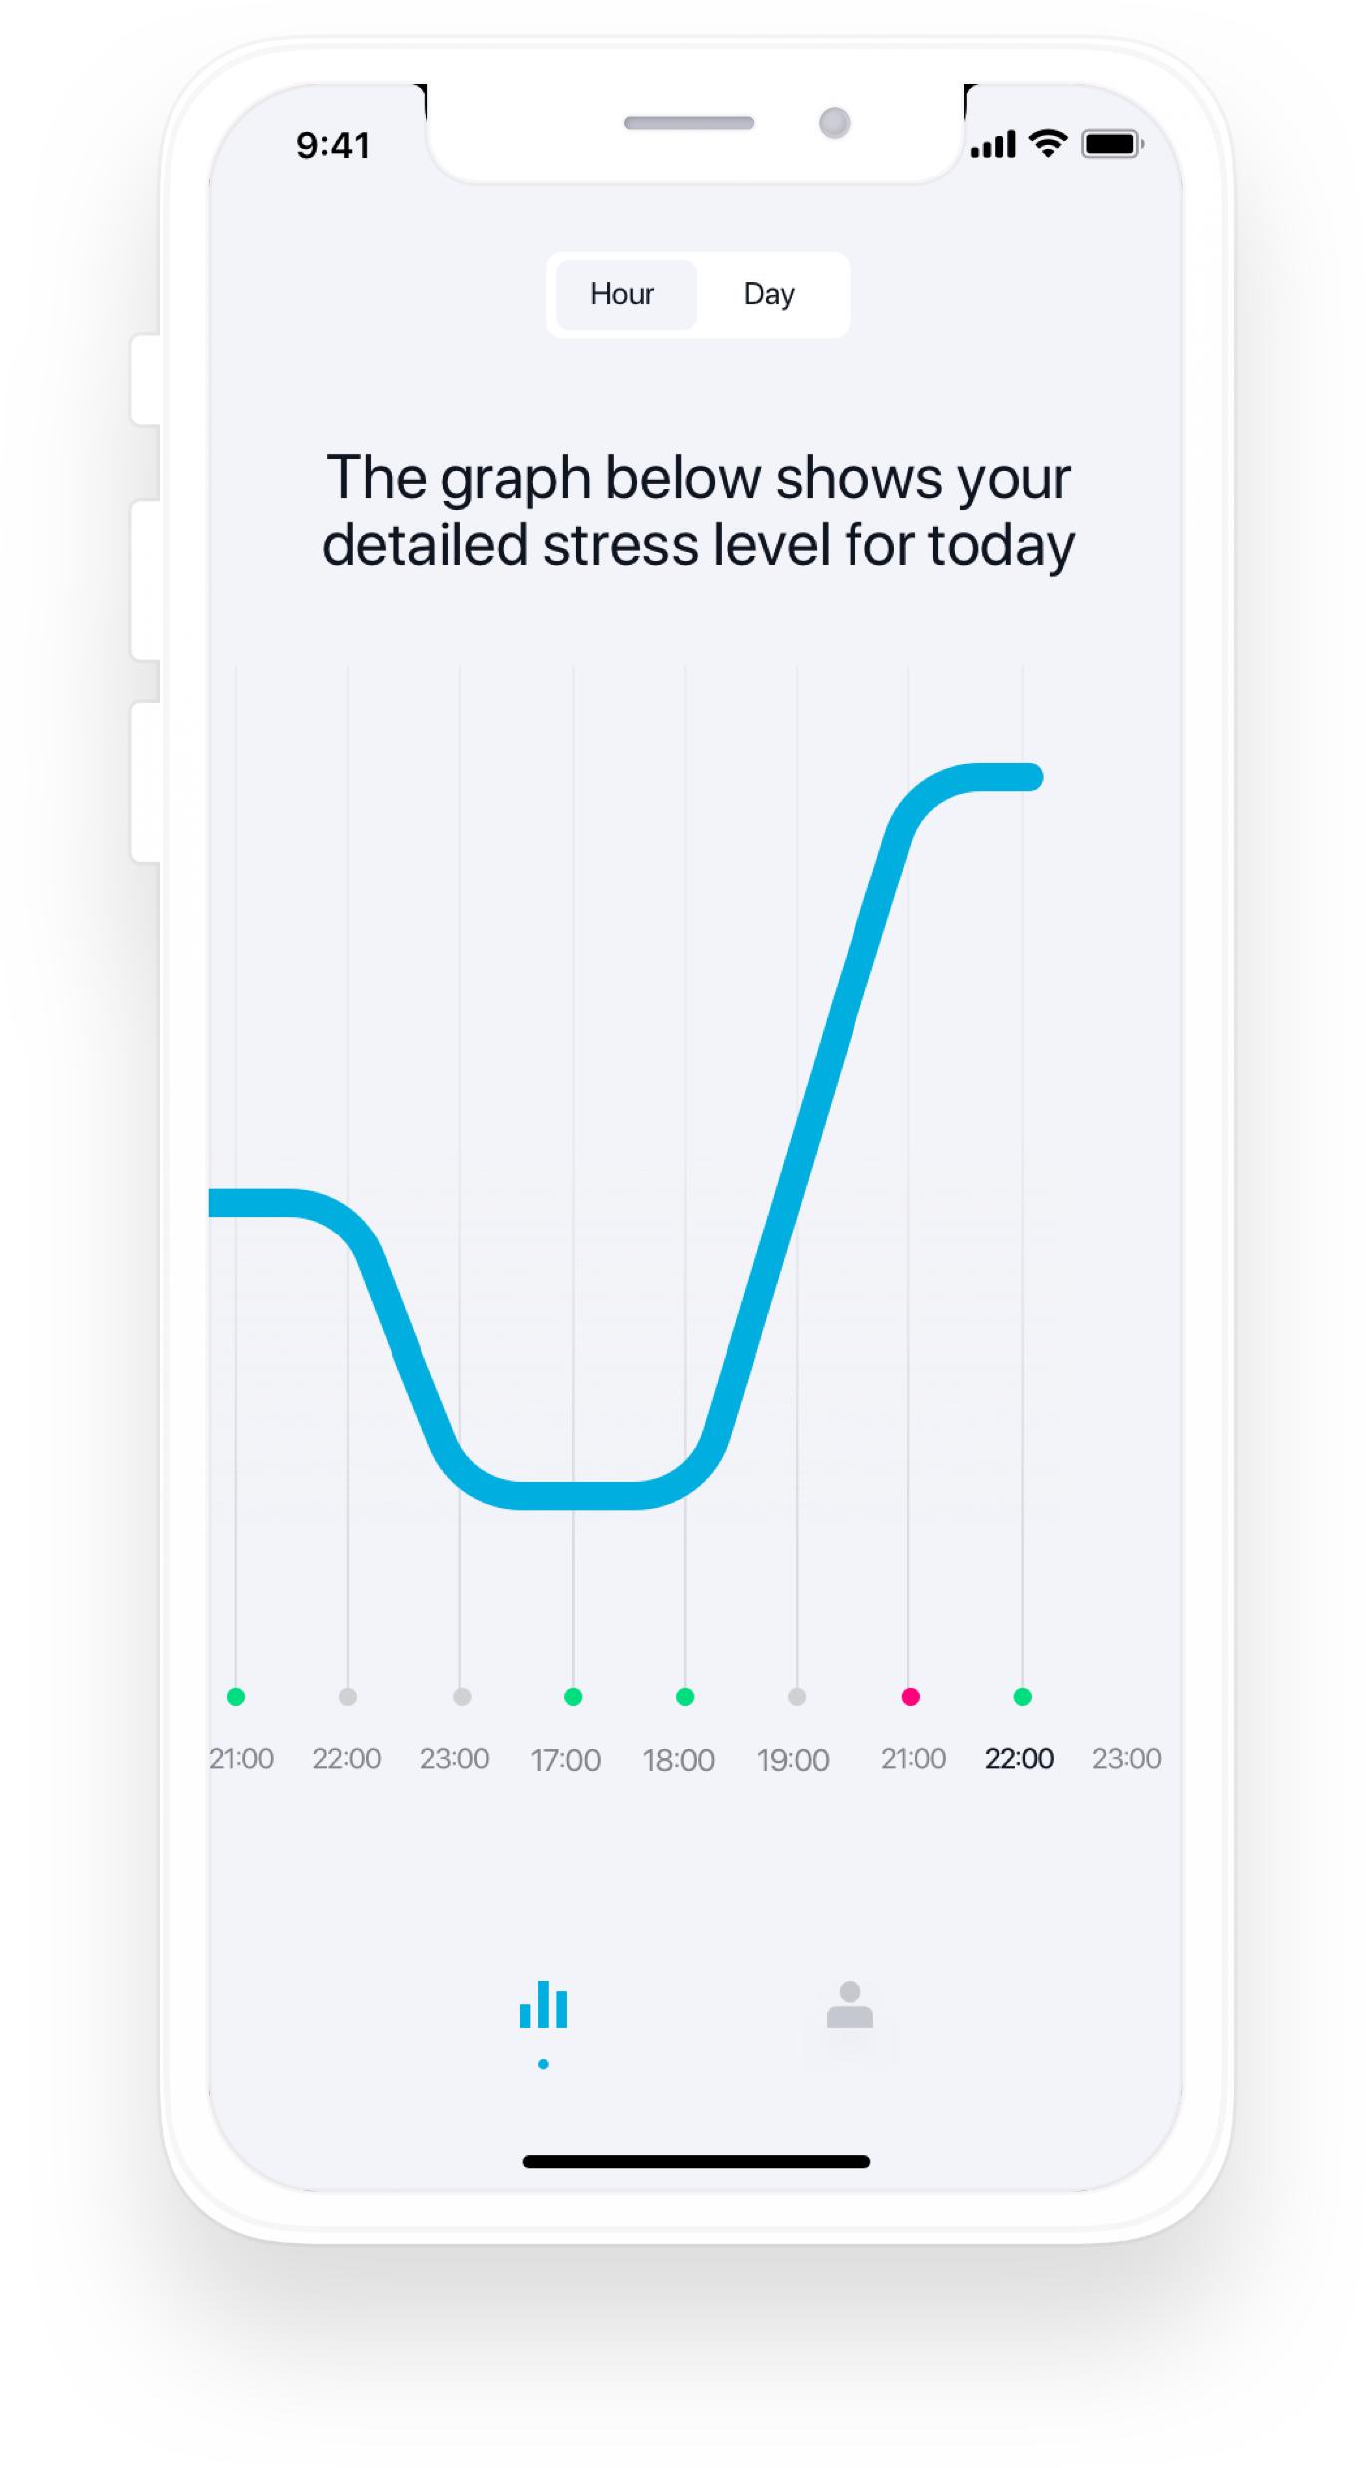
Coaching App
Notes:
Current status of development or product (POC finished, roll out,…)
Future

Slide 9
Look for strong specialized partners
Define proper needs & strategy
Walk before you start running
Refine your first strategy
Secure your data
Notes:
What suggestions do you have for other companies who want to implement AI/ML?
What were the hardest problems you had to tackle?
Are you eager to use AI/ML again if you are faced with similar problems? Would you recommend this way of working to other companies?
Do’s & dont’s

Slide 10
info@monoa.tech
www.monoa.tech
MoNoA© - Confidential - Patent Pending 820046-BE-U

