Slide 1
Flemish Policy Agenda
Artificial Intelligence
Jo Bultreys Program Advisor AI & CS

Slide 2
Building blocks
AI
CS
Strategic Basic Research
12 MEUR
8 MEUR
Business Implementation
13 + 3 MEUR
9 MEUR
Flanking Policy
5 MEUR
3 MEUR

Slide 3
Implementation – VLAIO supports:
Stimulate inflow
Awareness raising
Coaching and advice
Support for training
Support for knowledge diffusion
Support for knowledge development
Support for implementation
The ‘regular’ toolbox:
VLAIO Business Advisors
Contract ‘entrepreneurship’
SME e-wallet
Collective programs for knowledge development and diffusion (COOCK, TETRA)
SME growth subsidy
Regular support for knowledge development (R&D&I)
European programs
Ad hoc:
Call TETRA AI (2019) – digitization

Slide 4
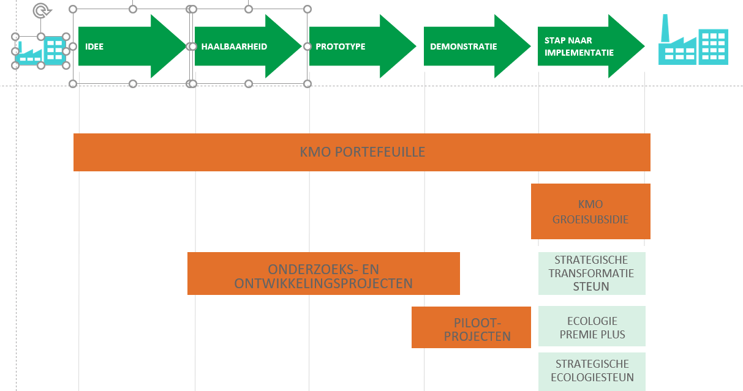
We cover the whole trajectory from idea to implementation
Stimulate inflow
Awareness raising
Coaching and advice
Support for training
Support for knowledge diffusion
Support for knowledge development
Support for implementation

Slide 5
VLAIO Advisors Support and advice made to measure
Starting from analysis of the individual business case
Referral to partners
Advice about legal barriers
Guide to subsidies and financing
Financial
situation
Ideas and plans
Growth ambition
Team
Market

Slide 6
Who to contact?
Don’t hesitate!
If your company has concrete and ambitious plans or ideas about AI/CS or others, please contact VLAIO for free tailor-made advice.
ai@vlaio.be or info@vlaio.be
0800 20 555
Jo.bultreys@vlaio.be

